Slide 1
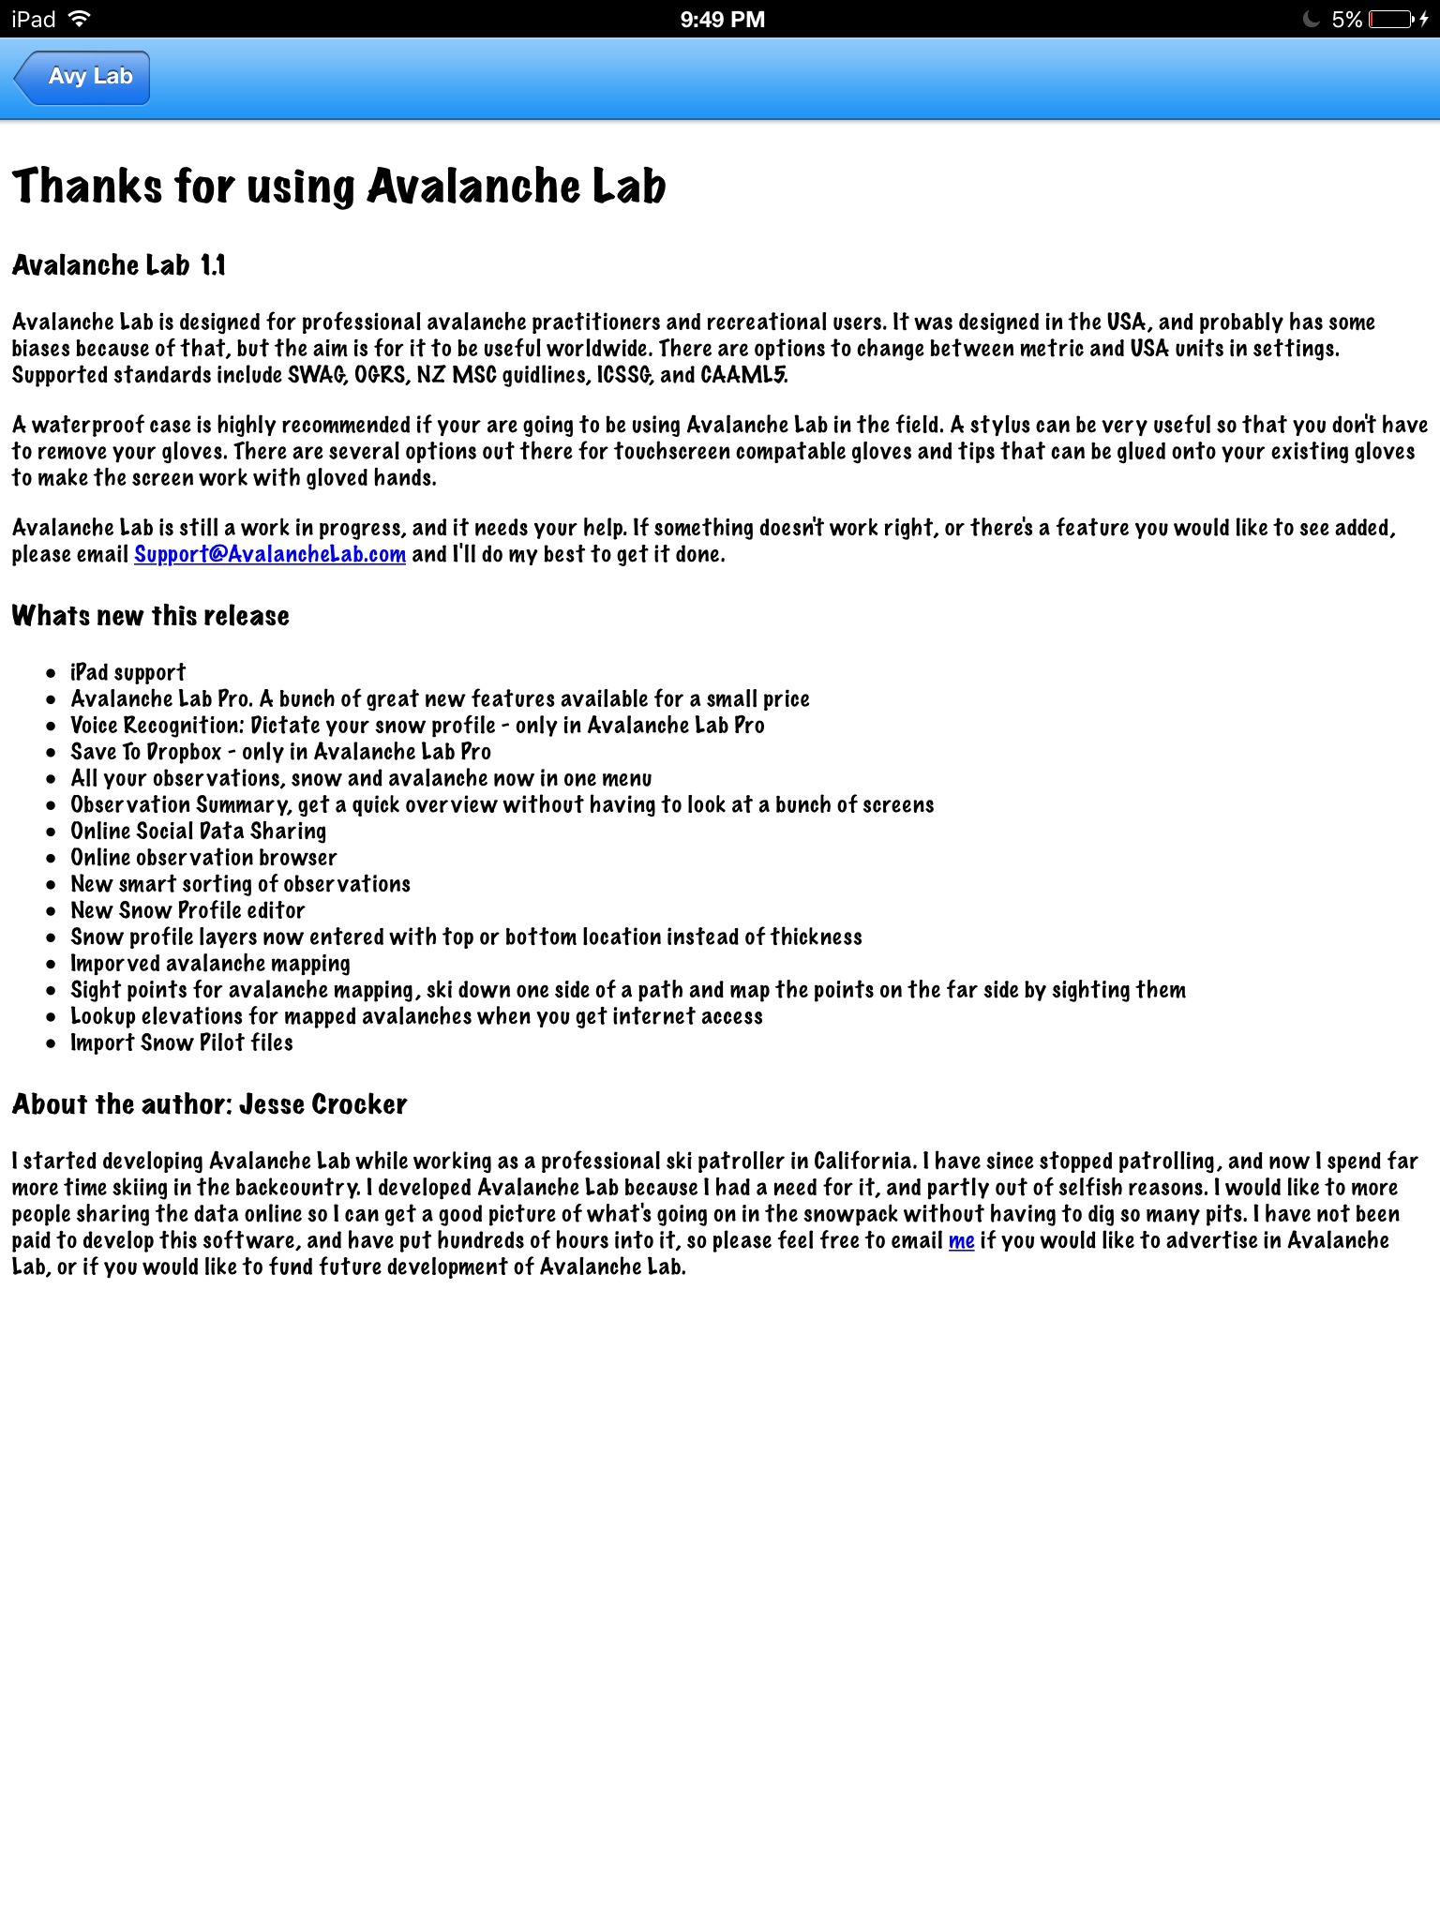
Free Version
Summary of Free Version:
What’s Great with this release:
IPad support
Observation Summary
Online Data Sharing
Smart Sorting of Observations
Improved Avalanche Mapping
Save for home feature
Import snow pilot data
Expanded Toolbox
Trip Planner
Reference info
Rescue Guide
Clinometer
Compass
Snow Crystal Card

Slide 2
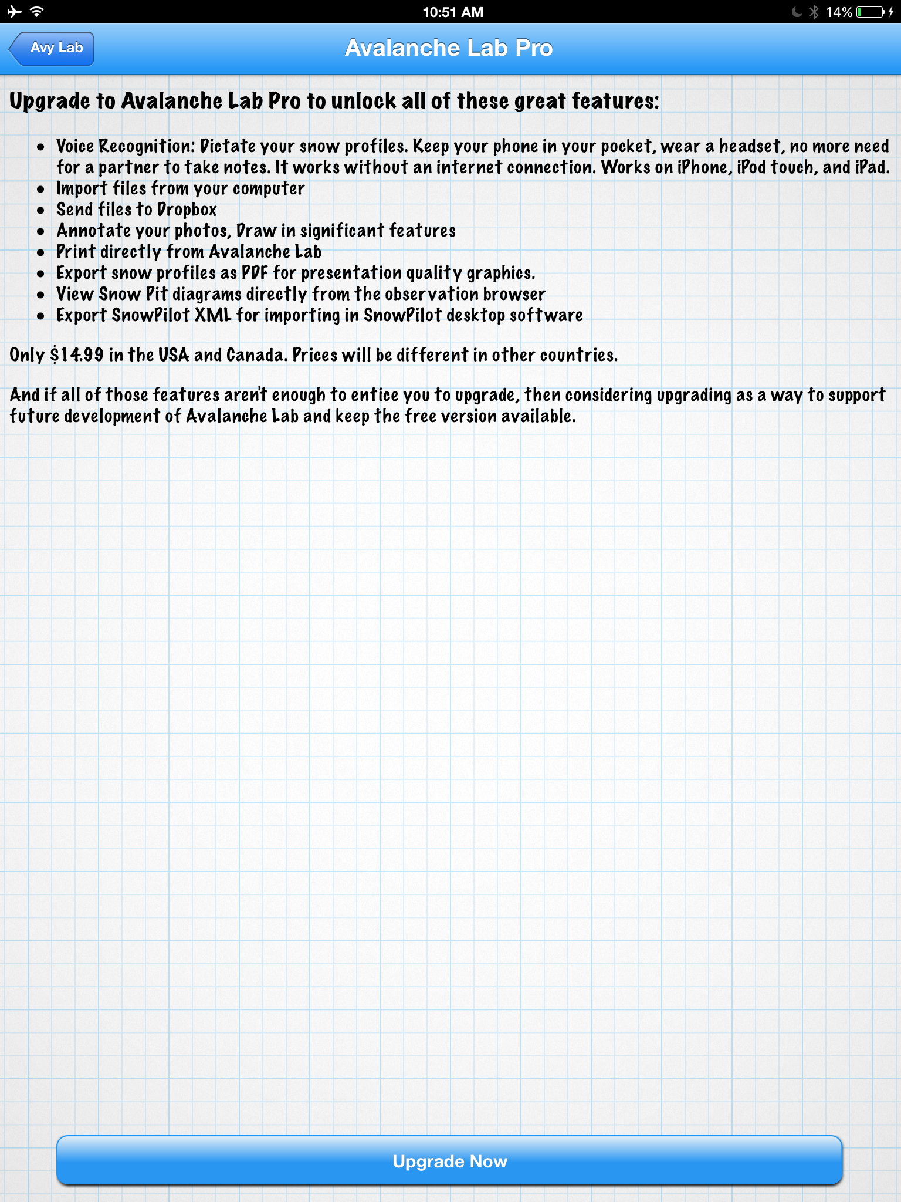
PRO Version: $19.99 Annual Donation
Summary of PRO Version:
What's new with The PRO Version:
Voice Recognition
Import/Download Files
Export as PDF
Export for Snow Pilot
Send Files to Drobox
Annotate Photos
Print from Avy Lab App
View Pit Diagrams in browser
Yellow Flag Calculator
Temperature Profiler
Snow Pit Layers

Slide 3
Main Screen
This is the Main landing page that is reached when the domain app.avalanchelab.org is reached, or the app is opened through a native app on a phone. This design should be responsive and adjust seamlessly from mobile, to tablet, to desktop. When the screen is scrolled down, the menu should transition to the next screen.
Front Range Forecast
AVALANCHE LAB
Notes:
The Login/sign up screen will allow users to create and manage their accounts. It should have the existing infrastructure to support paid subscriptions, and manage users with the existing server infrastructure.
Features:
Responsive Design
State view based on current location
©2010 Avalanche Lab. All Rights reserved.

Slide 4
Main Screen > W/Scroll Down
Notes:
The Login/sign up screen will allow users to create and manage their accounts. It should have the existing infrastructure to support paid subscriptions, and manage users with the existing server infrastructure.
Main Menu
Log In/Sign Up
Record Data
Features:
Login/signup goes away after sign in. Says “Hello, First Name, Last Name”
Map shrinks down to fixed size on top to accommodate 5/6 menu items accordingly.
Researcher tab hidden unless applicable
View Data
Share Data
Toolbox
Settings
Researchers
©2010 Avalanche Lab. All Rights reserved.

Slide 5
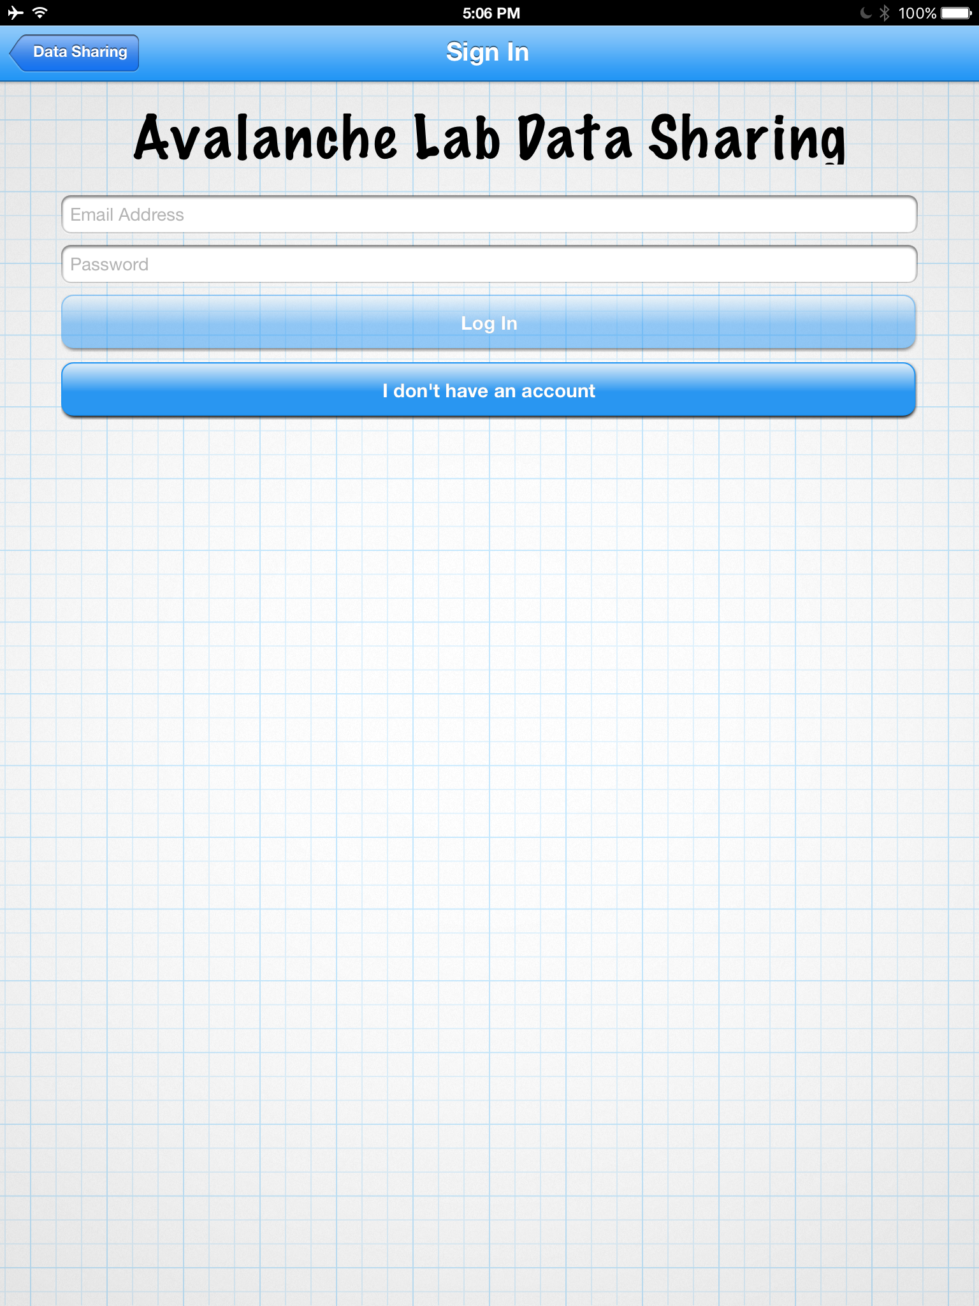
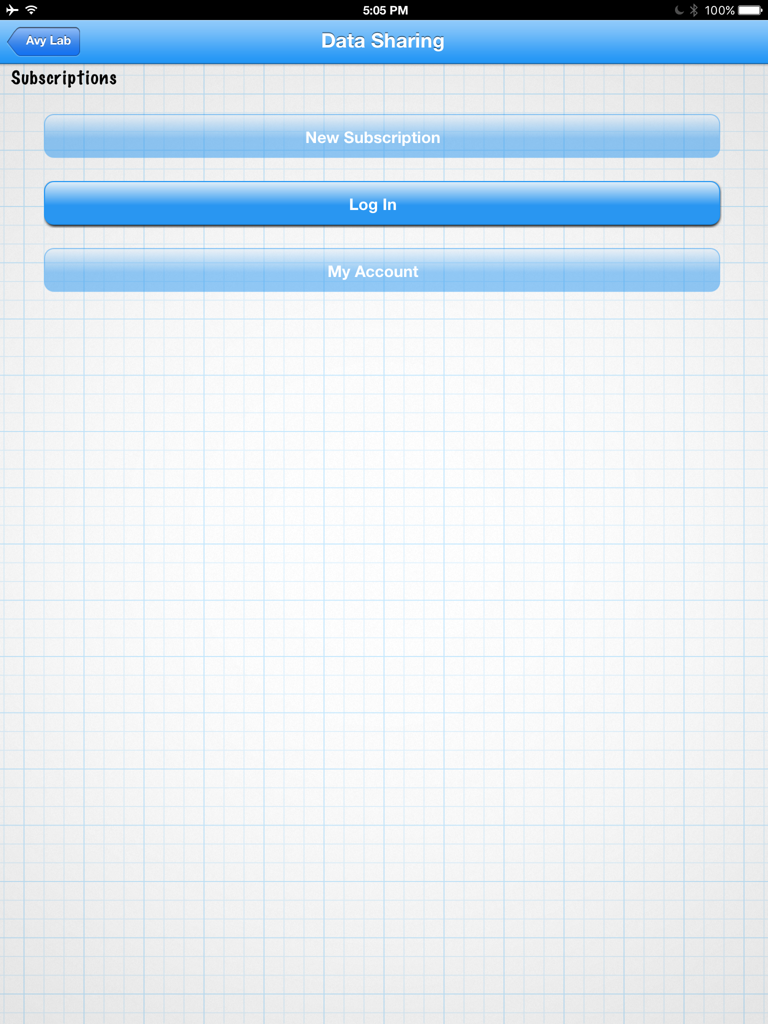
Main Screen > W/Scroll Down > Login/Sign up
Notes:
The Login/sign up screen will allow users to create and manage their accounts. It should have the existing infrastructure to support paid subscriptions, and manage users with the existing server infrastructure.
USER LEVELS:
- Public
Free User
PRO User
Researcher
Front Range Forecast
Login/Signup
Features:
All users Free and Donation users REQUIRE accounts to sign in and use features. This insures that an email and some info are exchanged for access to the app.
©2009 Renaissance Recreation. All Rights reserved.
Ad Space
Ad Space
©2009 Renaissance Recreation. All Rights reserved.

Slide 6
Main Screen > Record Data Drop-down Menu
Front Range Forecast
Main Menu
Record Data
Notes:
When the ”Record Data” button is clicked the menu should show a drop-down menu with the different types of observations that can be logged. When you select the observation button, it will either launch the obs. or a sub menu, so the user can select the detail of obs. they want to do.
Snow Observation
Weather Observation
Avalanche Observation
View Data
Share Data
Features:
Allows for Recording snow observations to SWAG, OGRE, NZ, CAAMML 5; standards.
Switch between metric and USA units
Toolbox
©2009 Renaissance Recreation. All Rights reserved.
Ad Space
Ad Space
©2009 Renaissance Recreation. All Rights reserved.

Slide 7
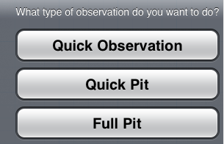
Main Screen > Record Data Drop-down Menu > Snow Obs. Sub-menu
Notes:
This is the snow obs. Sub-menu. The user can select the type of snow obs. To record. “Test pit” and “full pit” will be selectable by PRO level users only.
Front Range Forecast
Snow Obs.
Quick Observation
Test Pit
Full Pit
Features:
Quick Observation is the only option for the Free App
Quick Pit and Full Pit are turned on for the PRO users
©2009 Renaissance Recreation. All Rights reserved.
Ad Space
Ad Space
©2009 Renaissance Recreation. All Rights reserved.

Slide 8
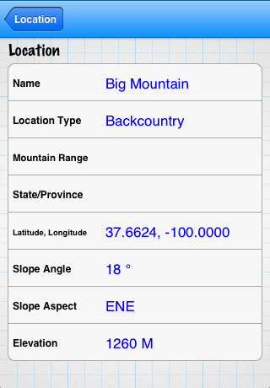
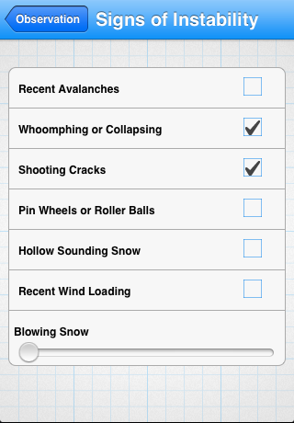
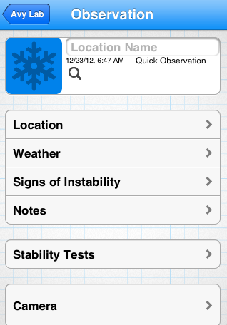
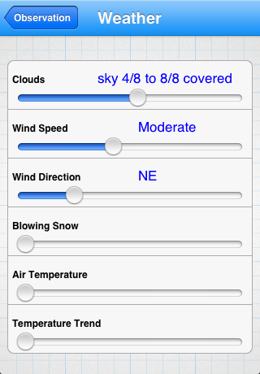
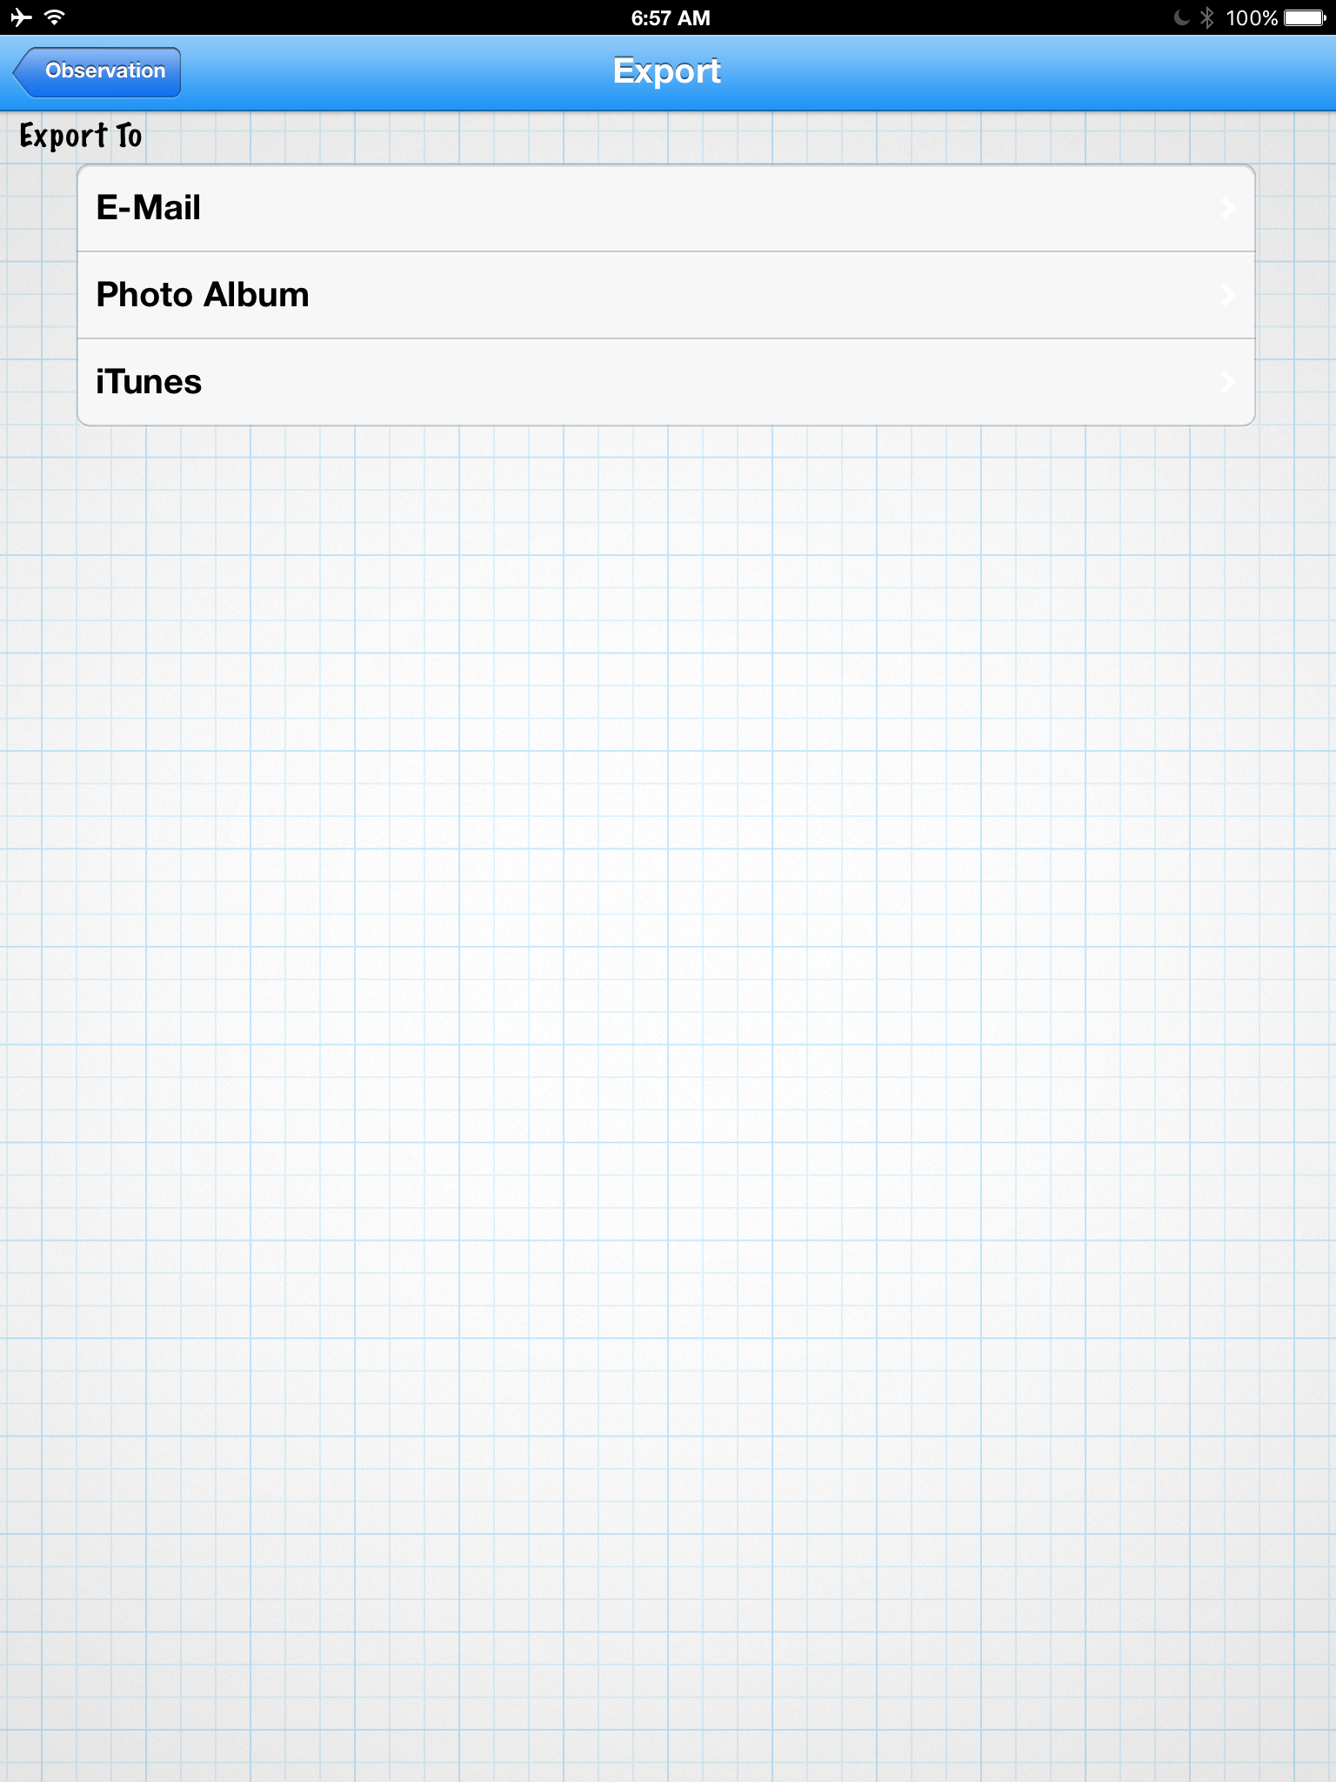
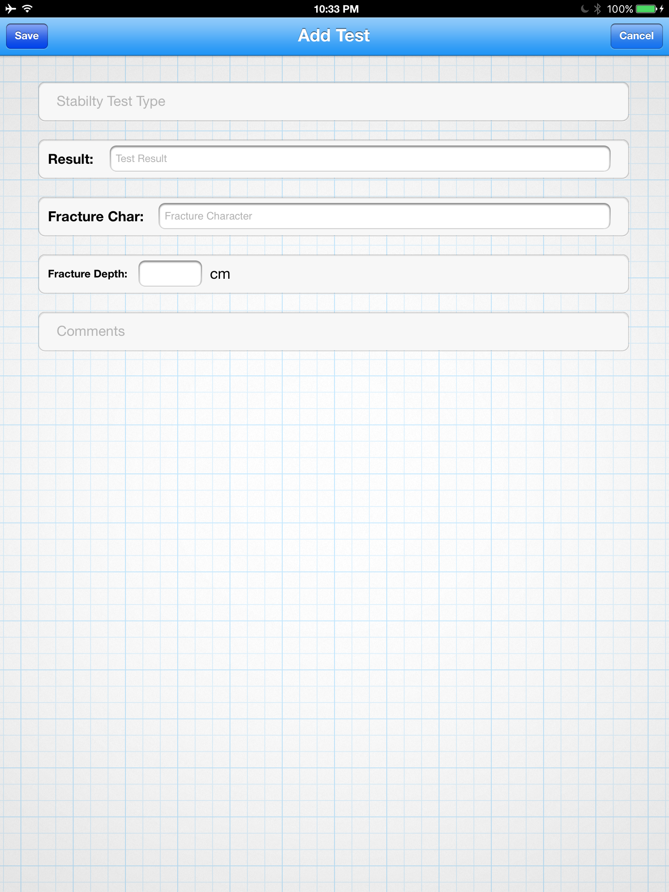
Main Screen > Record Data Drop-down Menu > Snow Obs. > Quick Observation
Notes:
The snow obs. Screen will allow all users to enter quick observation data. These base functions will be included in the “test & full pit” PRO. The screen will launch sub-screens for location, weather, signs of instability, log stability tests, access the camera, notes, and export.
Front Range Forecast
Quick Obs.
Features:
Location logging
Weather obs
Signs of instability
Log Stability tests
Access to camera
Take notes
Export observations
©2009 Renaissance Recreation. All Rights reserved.
Ad Space
Ad Space
©2009 Renaissance Recreation. All Rights reserved.

Slide 9
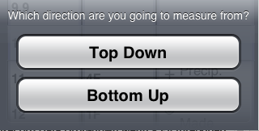
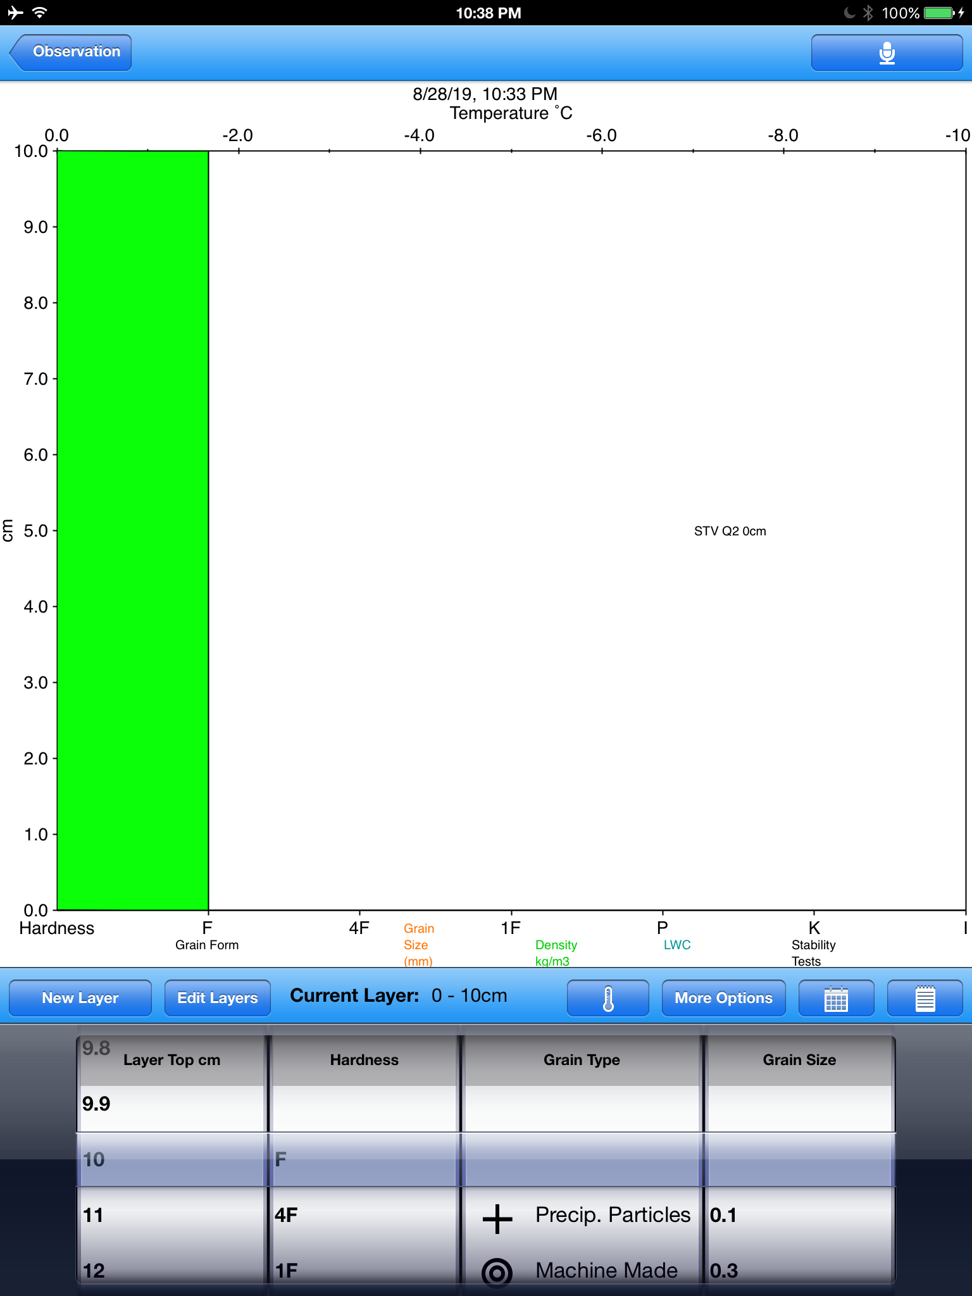
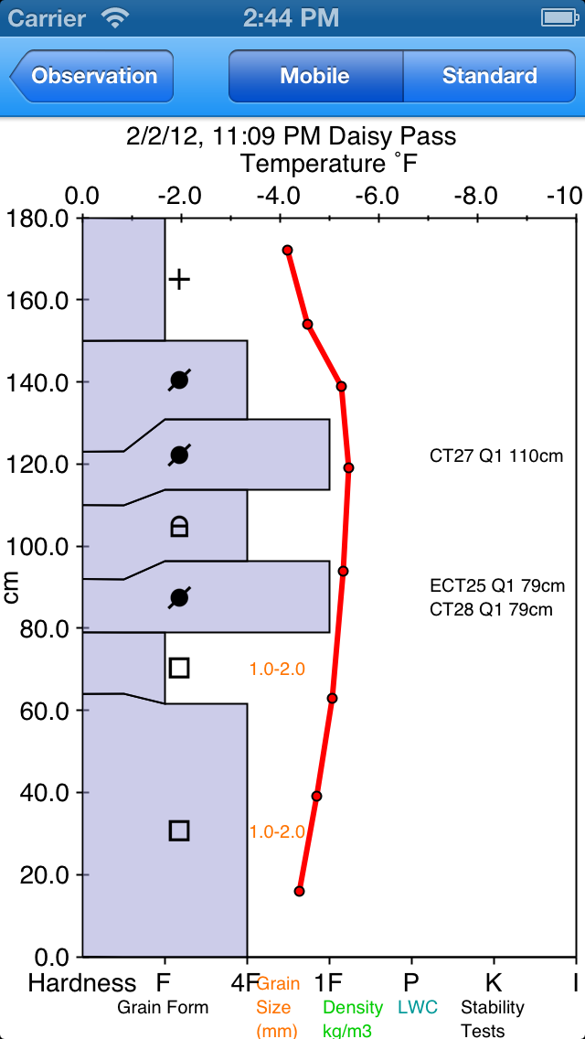
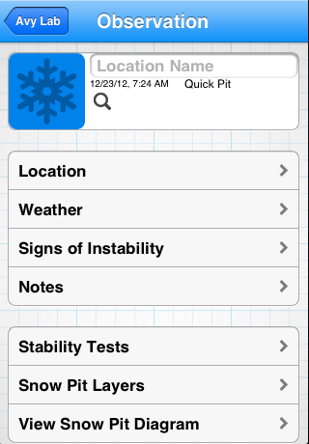
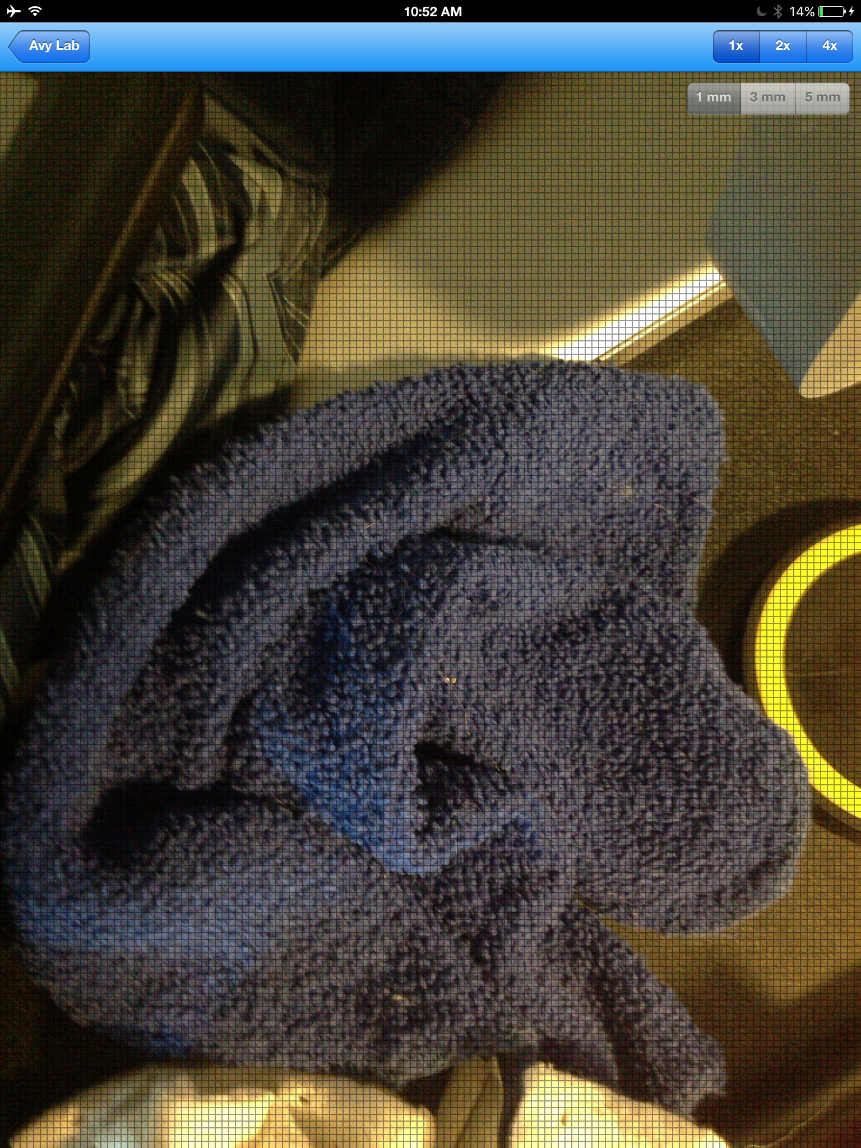
Main Screen > Record Data Drop-down Menu > Snow Obs. > Test Pit (PRO only)
Notes:
This “test pit” will only be accessed by PRO users. It will allow them to view and access all of the features of the “snow obs” page plus the addition of viewing and editing snow layers and snow pits. The only change is there needs to be a new button added after “snow pit layer” that says “calculate yellow flags”. This will trigger an analysis of their data from the snow layers, preforming the calculations and labeling the layers with the appropriate flags on the “snow pit diagram” screen.
Front Range Forecast
Test Pit
Features:
Same Base Features as Quick Obs
Addition of Snow Pit Layers
View Snow Pit Diagram
Calculate Yellow Flags
Record snow crystals
©2009 Renaissance Recreation. All Rights reserved.
Ad Space
Ad Space
©2009 Renaissance Recreation. All Rights reserved.

Slide 10
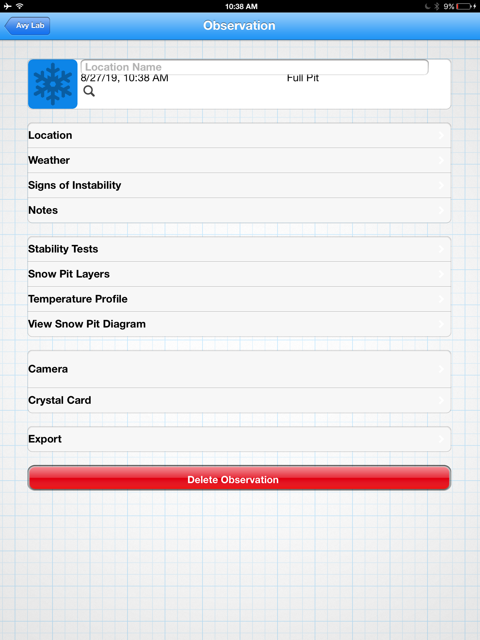
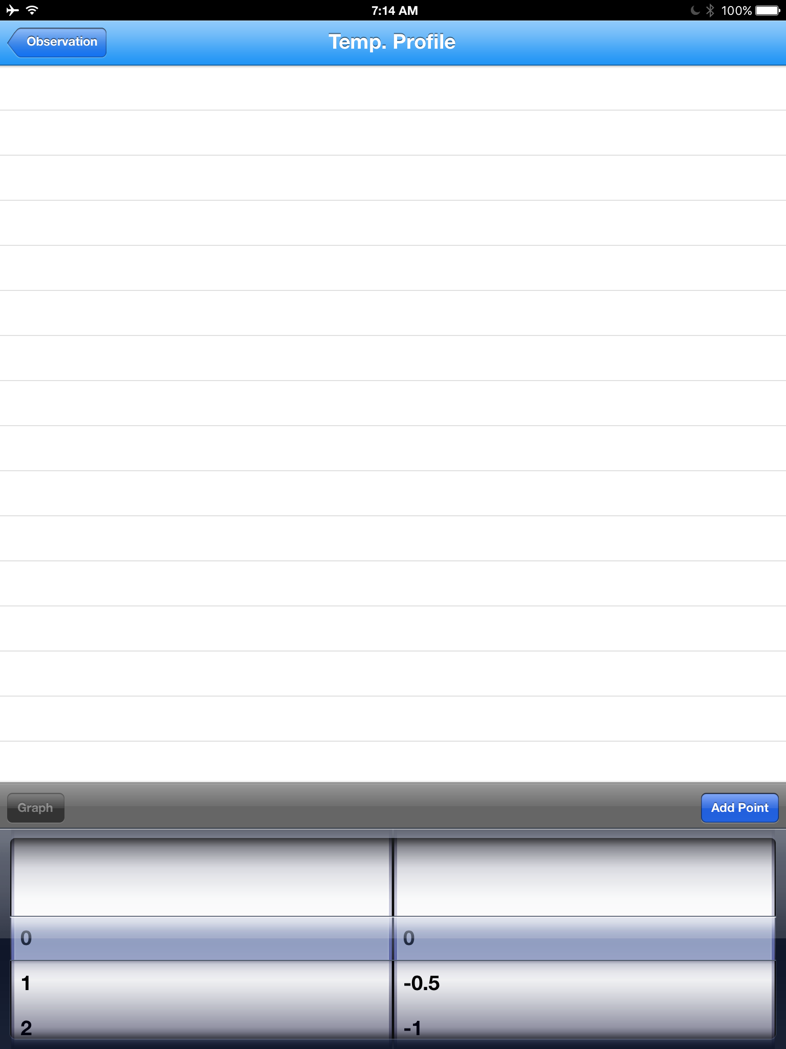
Main Screen > Record Data Drop-down Menu > Snow Obs. > Full Pit (PRO only)
Notes:
The Full Pit is the same as the quick pit, but with the addition of a temperature profile added to the menu.
Front Range Forecast
Full Pit
Features:
Addition of Temp Profile to Pit Diagrams
©2009 Renaissance Recreation. All Rights reserved.
Ad Space
Ad Space
©2009 Renaissance Recreation. All Rights reserved.

Slide 11
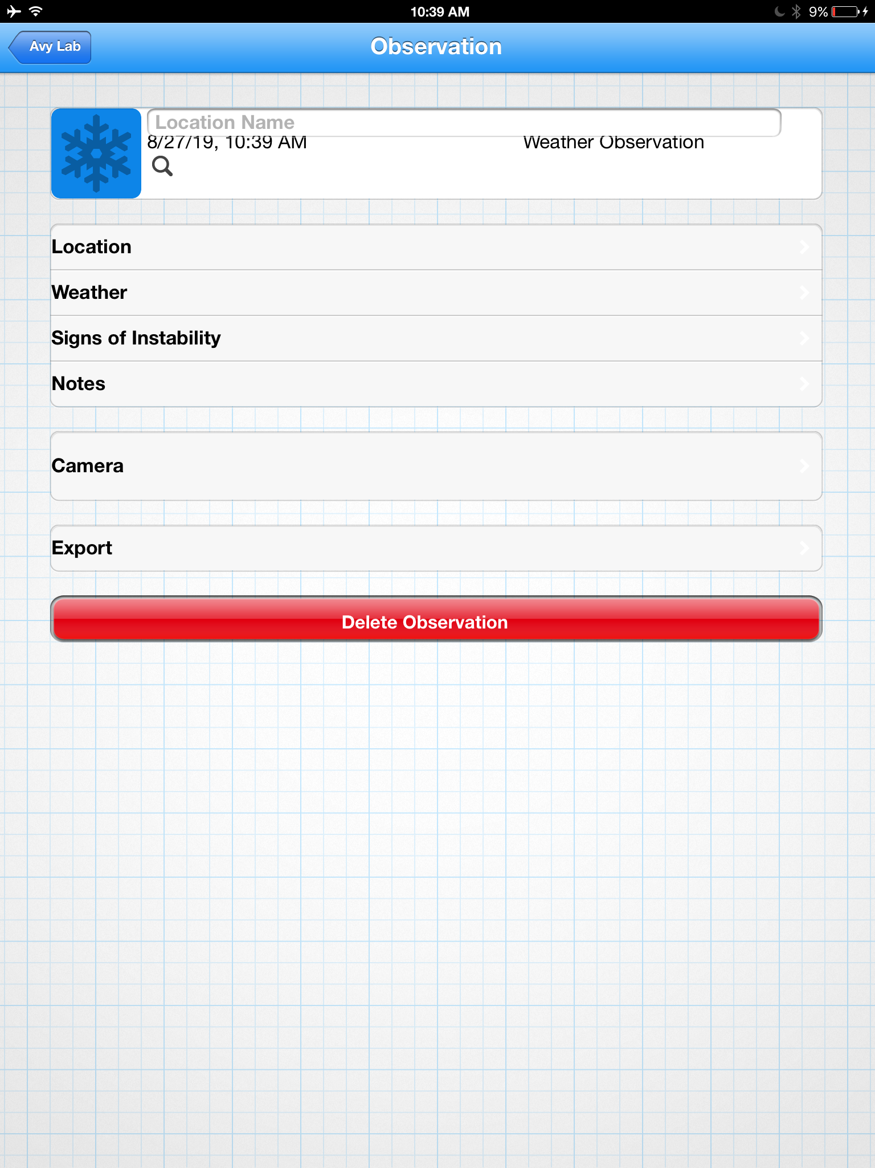
Main Screen > Record Data Drop-down Menu > Weather Obs.
Notes:
The “weather obs.” Screen will be accessed from any observation menu (Snow, Weather, Avalanche). It will be consistent across all views PRO and free versions.
Needs a check box at the end that says “Key Obs”, and this will allow the obs to be saved for review later on in the trip plugin.
Front Range Forecast
Weather Obs.
Features:
Records weather obs with pin-point location
Easy to enter weather obs
Record Key Obs for Review later on the trip
Record Notes
Use Camera/Save Photo
©2009 Renaissance Recreation. All Rights reserved.
Ad Space
Ad Space
©2009 Renaissance Recreation. All Rights reserved.

Slide 12
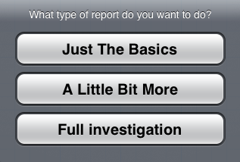
Main Screen > Record Data Drop-down Menu > Avalanche Obs. Sub-Menu
Notes:
This is the sub menu that comes up when the “avalanche obs.” Is selected. It is fully accessed by all users to the app.
Front Range Forecast
Avalanche Obs.
Avalanche Observations
Quick Obs./Note
A Quick Investigation
Features:
Allows ALL users to record observations in any specificity
Uses avalanche mapping tool for sighting points remotely
Full Investigation
©2009 Renaissance Recreation. All Rights reserved.
Ad Space
Ad Space
©2009 Renaissance Recreation. All Rights reserved.

Slide 13
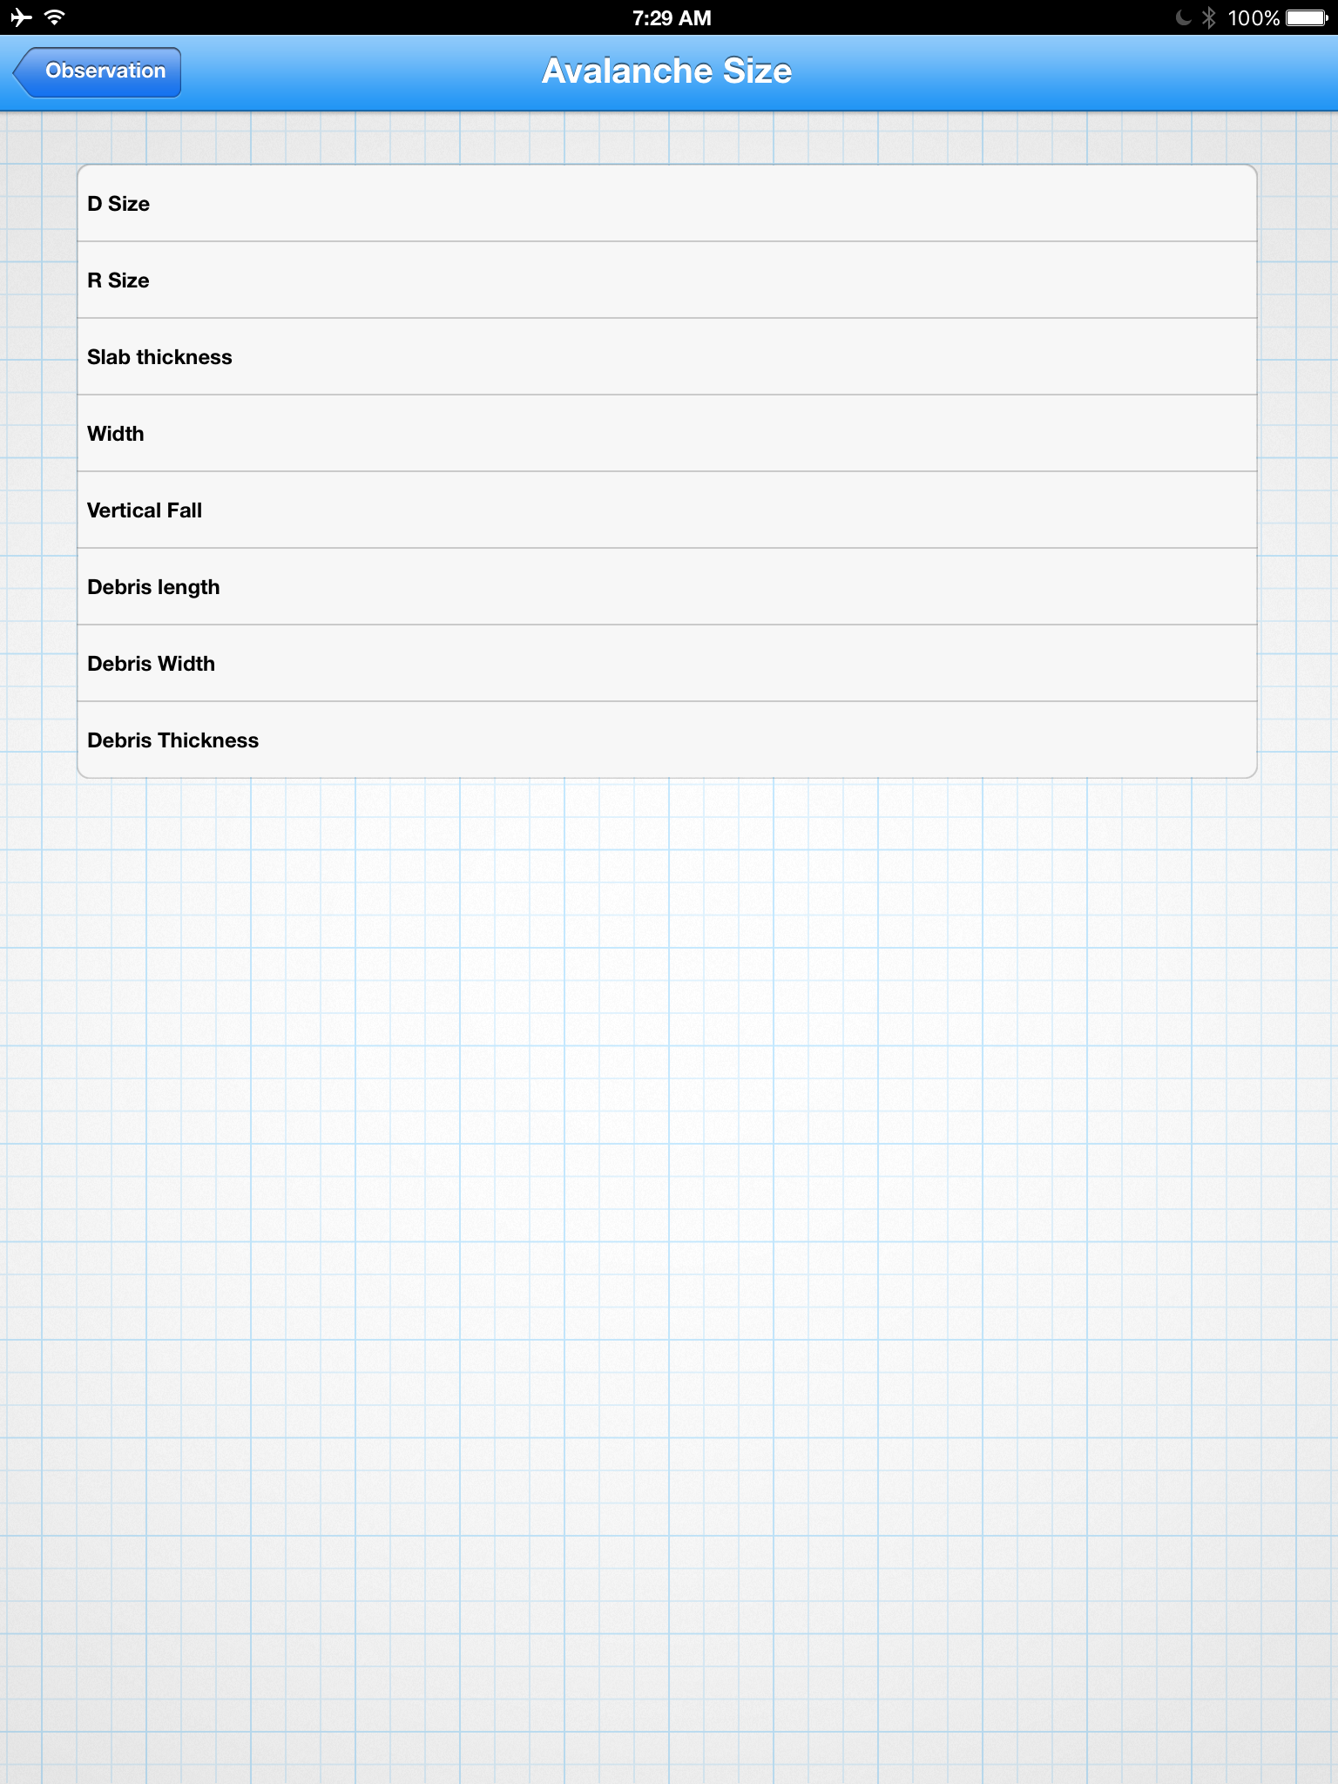
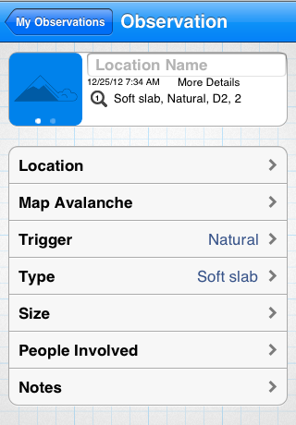
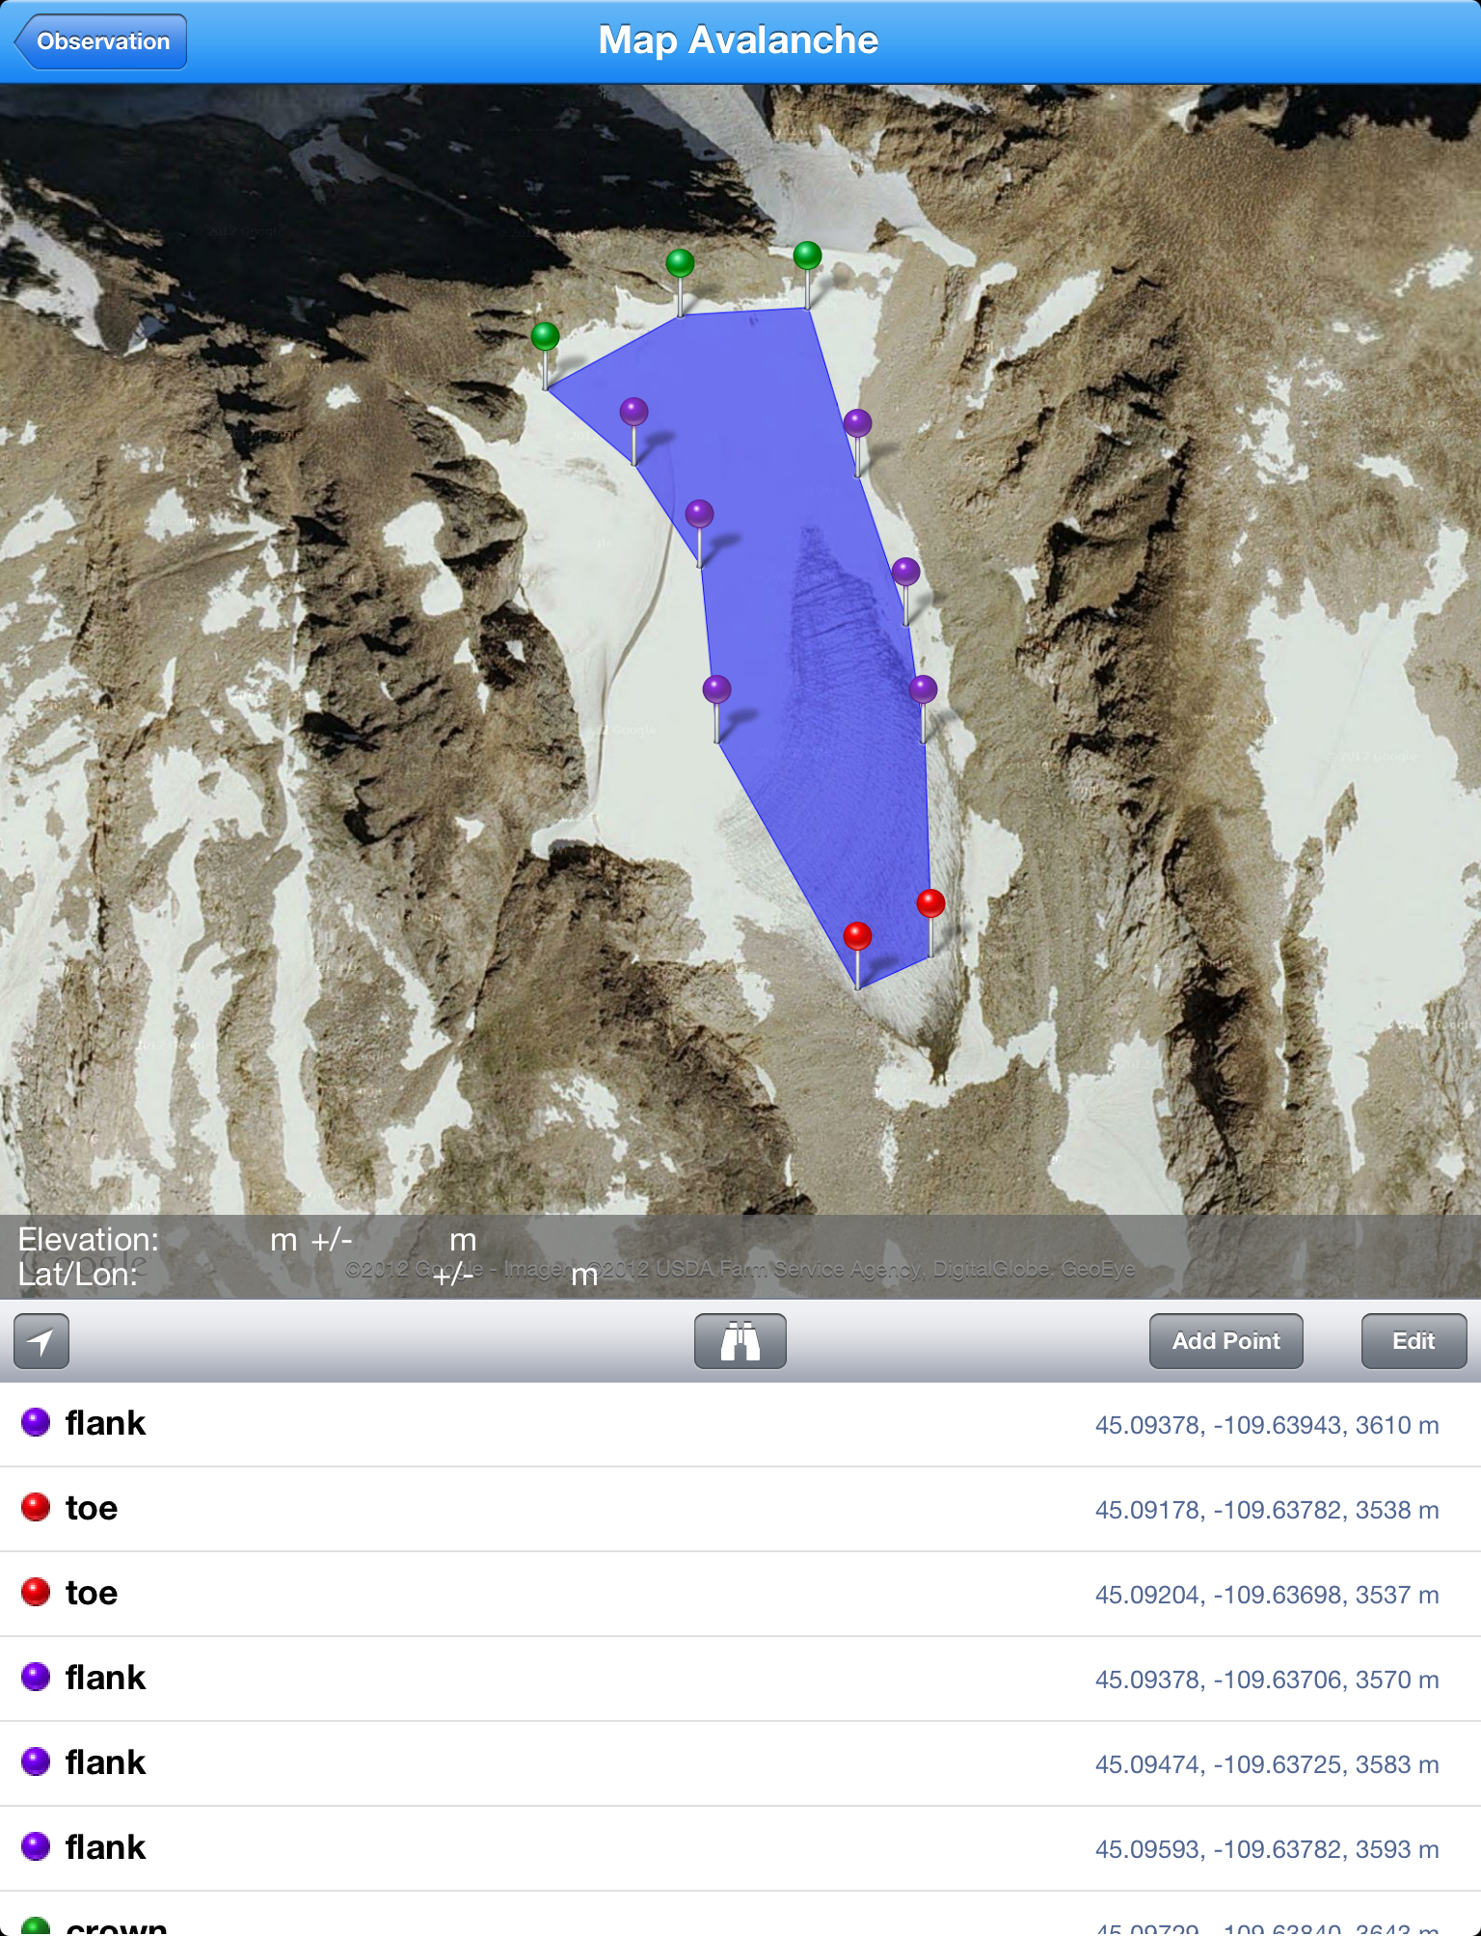
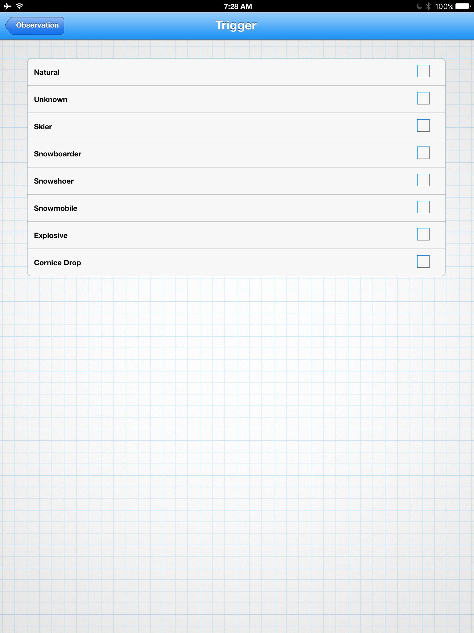
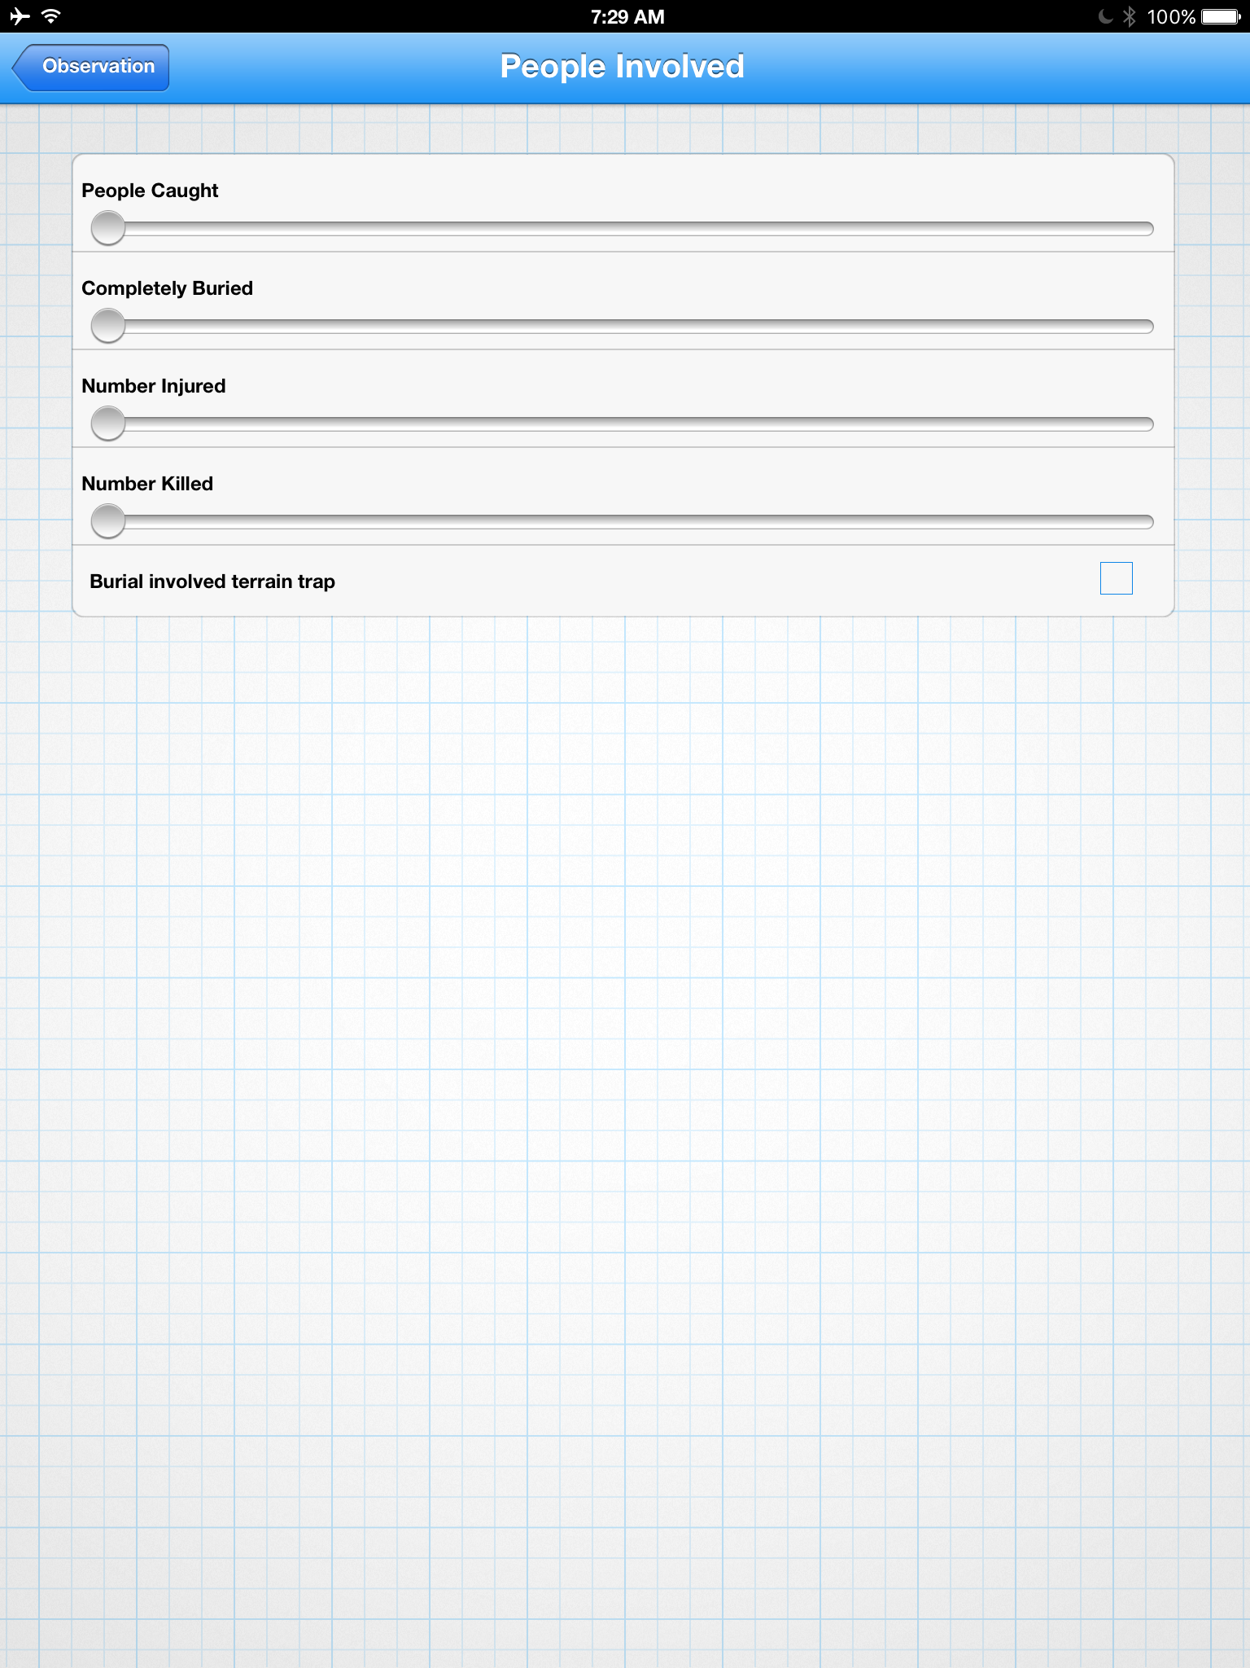
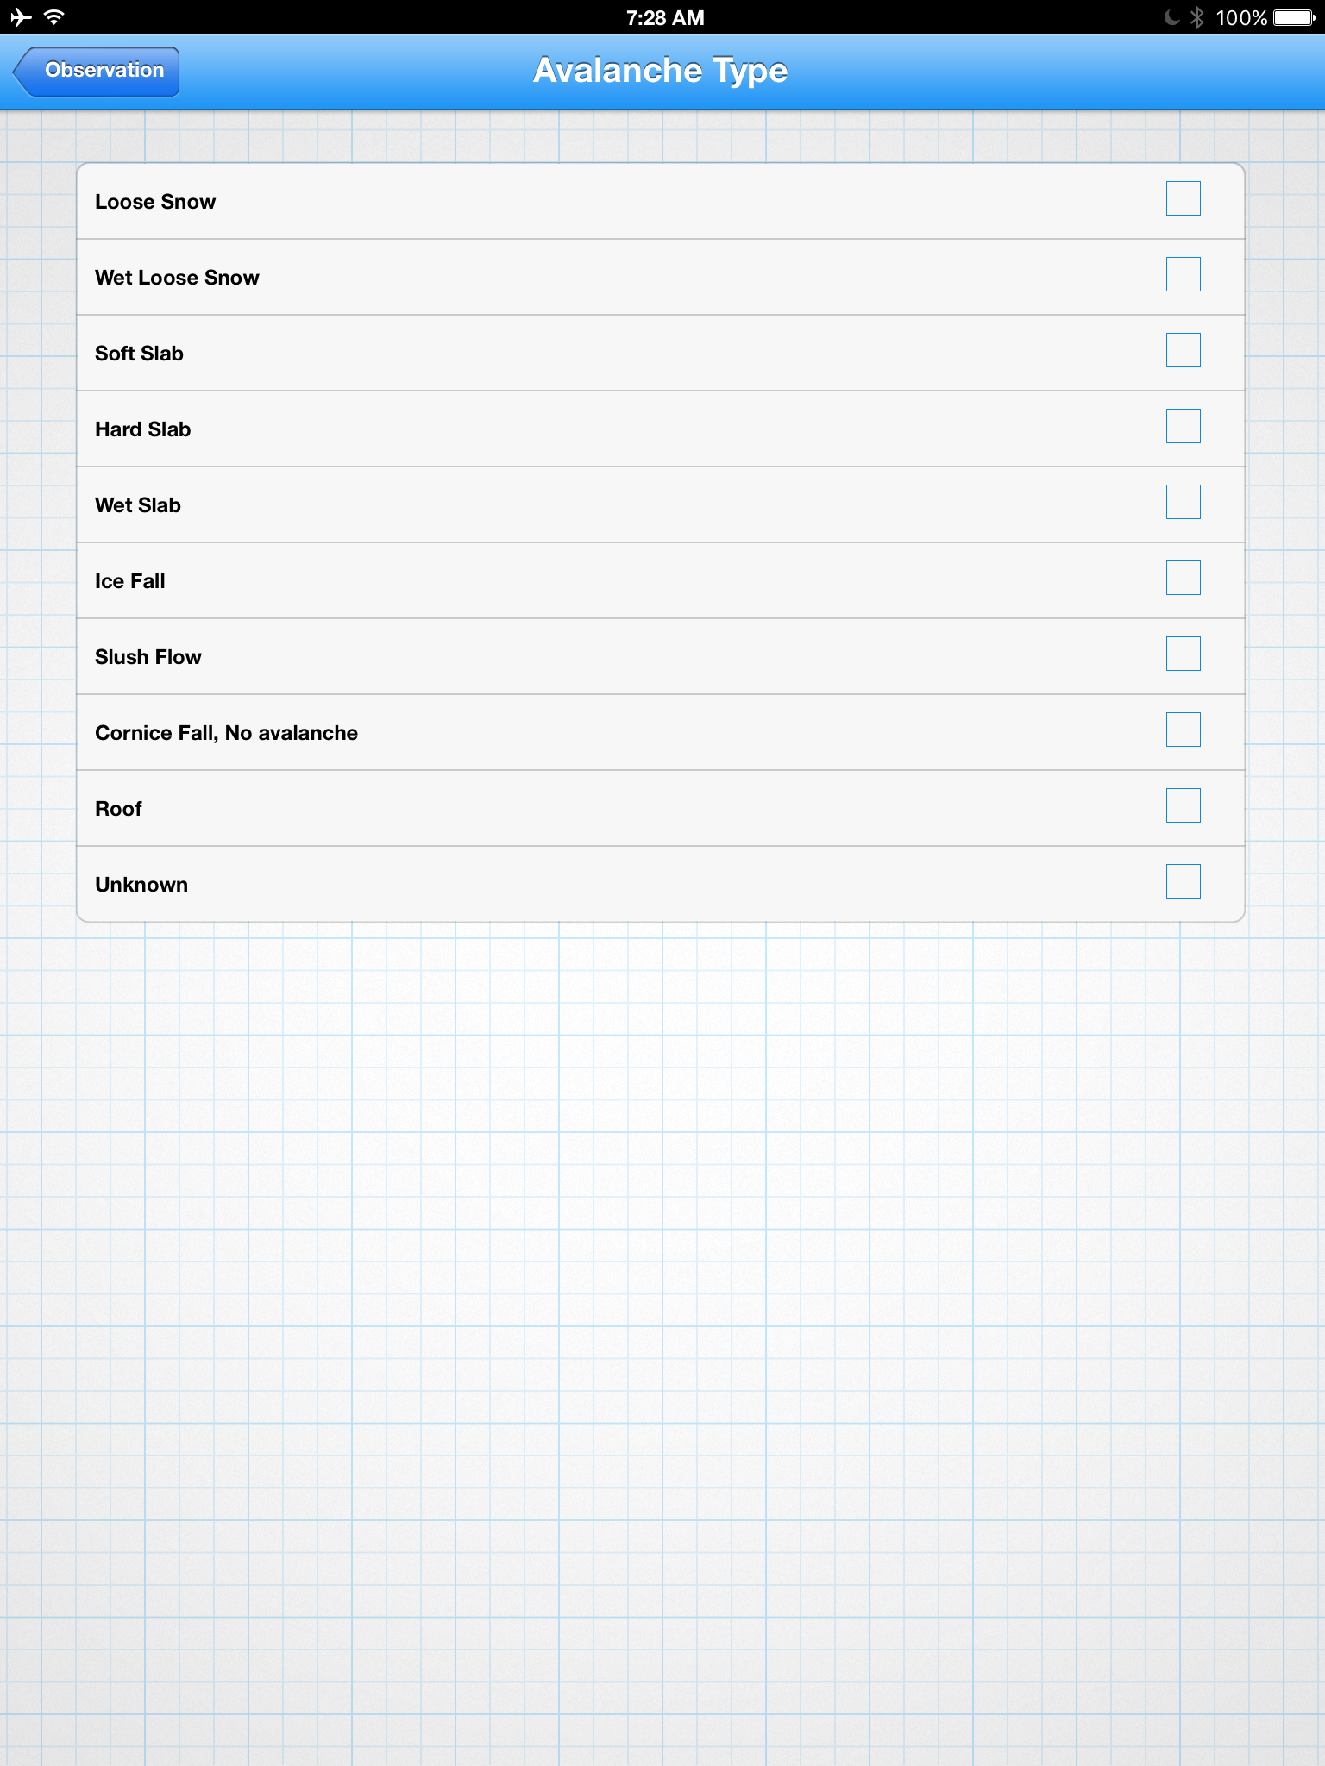
Main Screen > Record Data Drop-down Menu > Avalanche Obs. > Quick Obs./ Note
Notes:
The “quick obs” allows ALL users to enter avalanche observations.. It includes the location and notes screen from prior screens. It also includes screens for entering triggers, type, size, people involved, and a feature for mapping slides remotely.
Front Range Forecast
Avy: Quick Obs.
Features:
“Map Avalanche” avalanche mapping tool is used to sight key points of an avalanche slide path remotely and with accuracy.
Pin- Point Location
Easy to enter avalanche info
Notes page
©2009 Renaissance Recreation. All Rights reserved.
Ad Space
Ad Space
©2009 Renaissance Recreation. All Rights reserved.

Slide 14
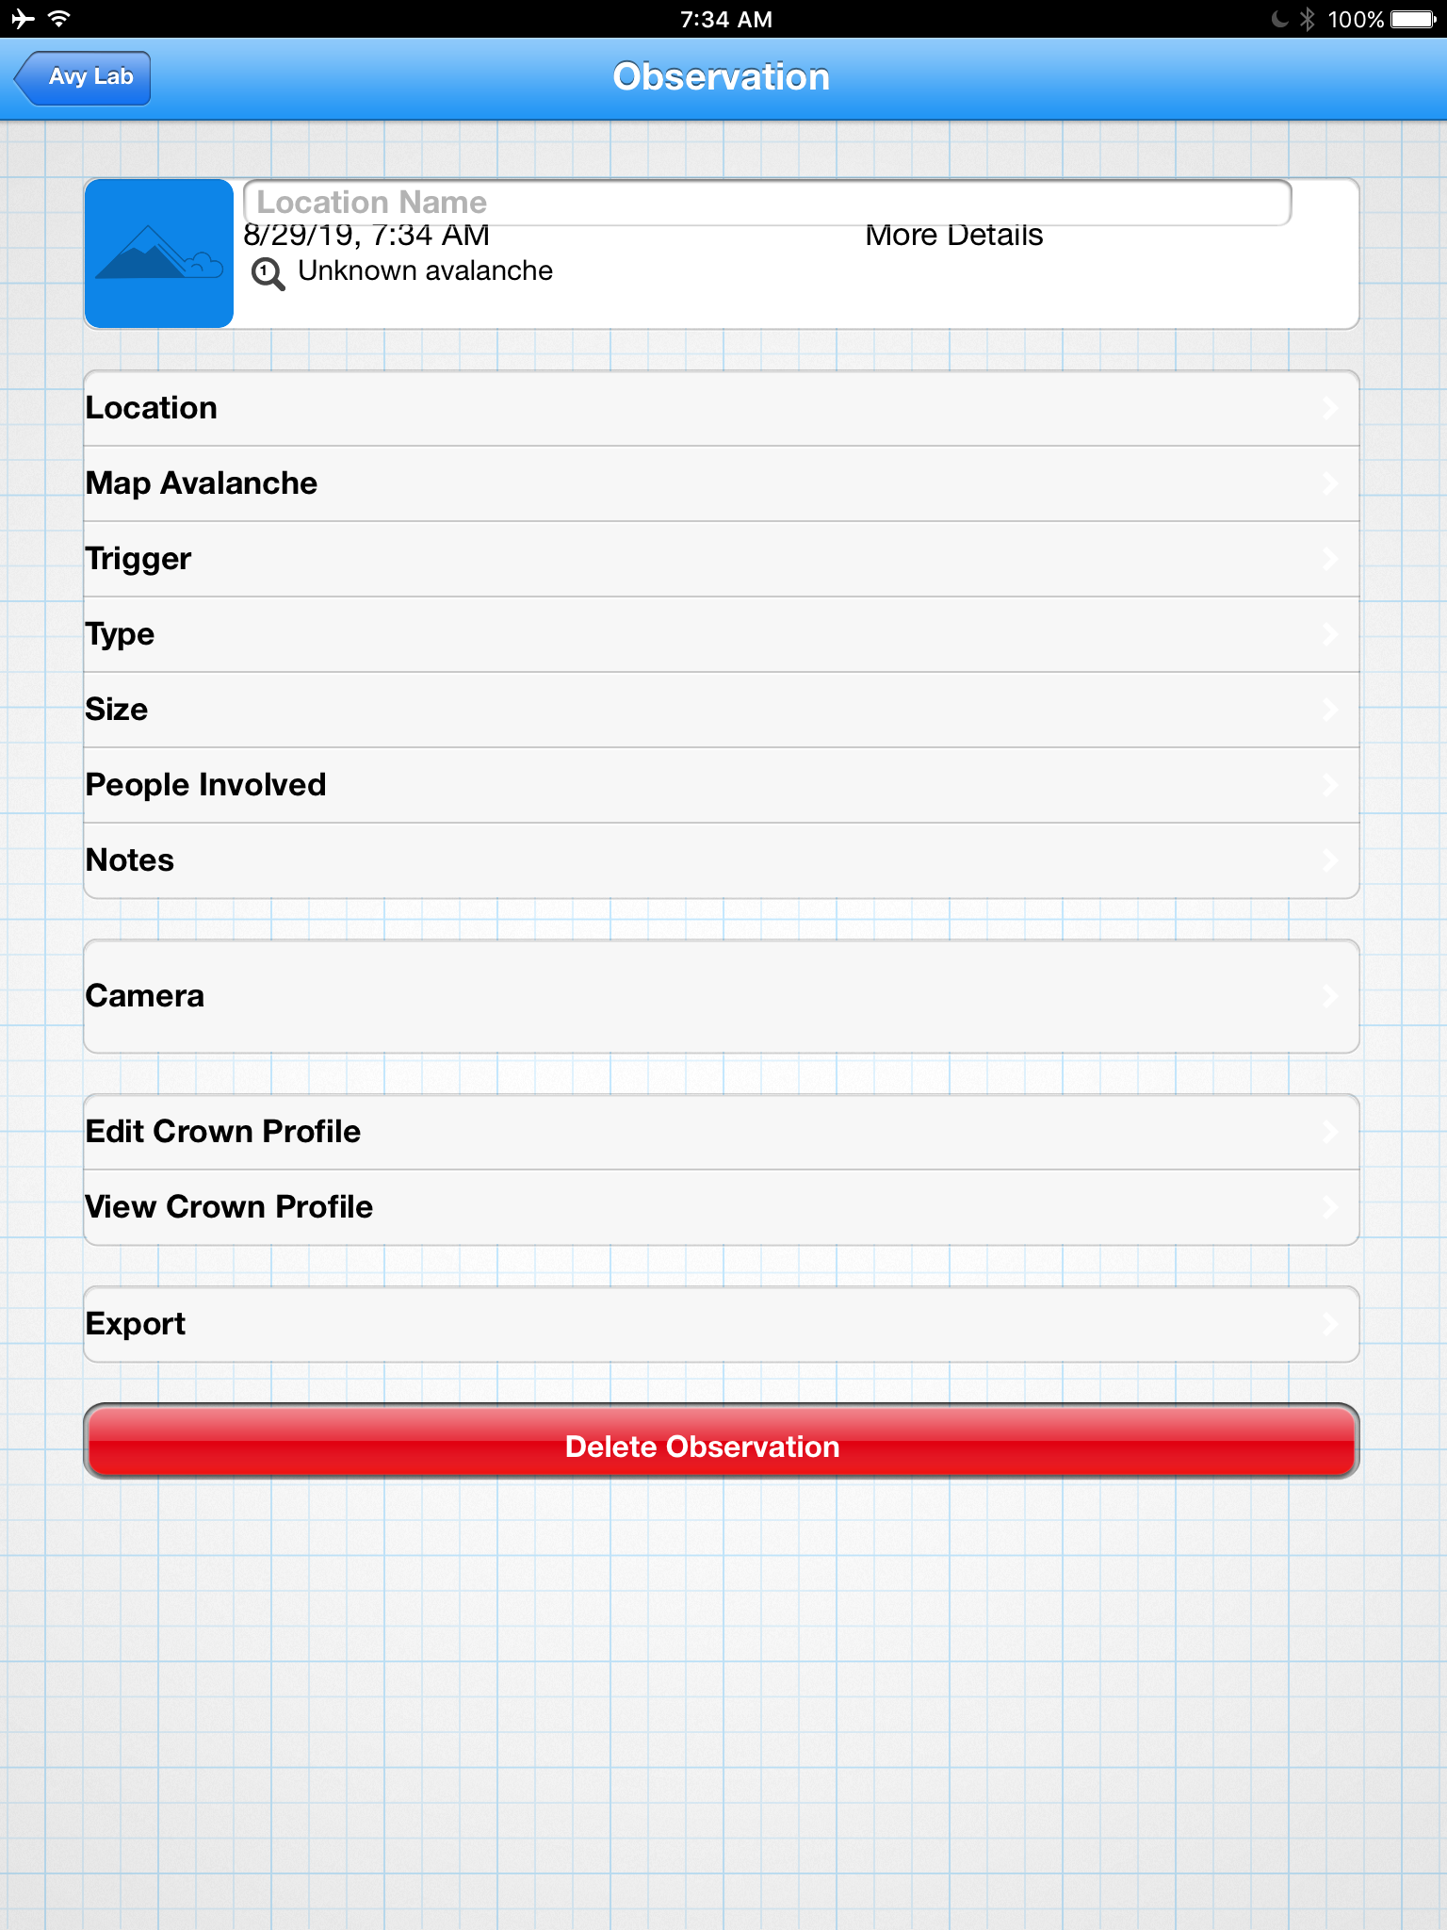
Main Screen > Record Data Drop-down Menu > Avalanche Obs. > Quick Investigation (PRO only)
Notes:
This is the same features of the “quick obs”, with the addition of the ability to view, and edit crown profiles.
Front Range Forecast
Avy: Quick Invest.
Features:
Standard base features as “quick Obs”
Addition ability to view/edit/create crown profiles
©2009 Renaissance Recreation. All Rights reserved.
Ad Space
Ad Space
©2009 Renaissance Recreation. All Rights reserved.

Slide 15
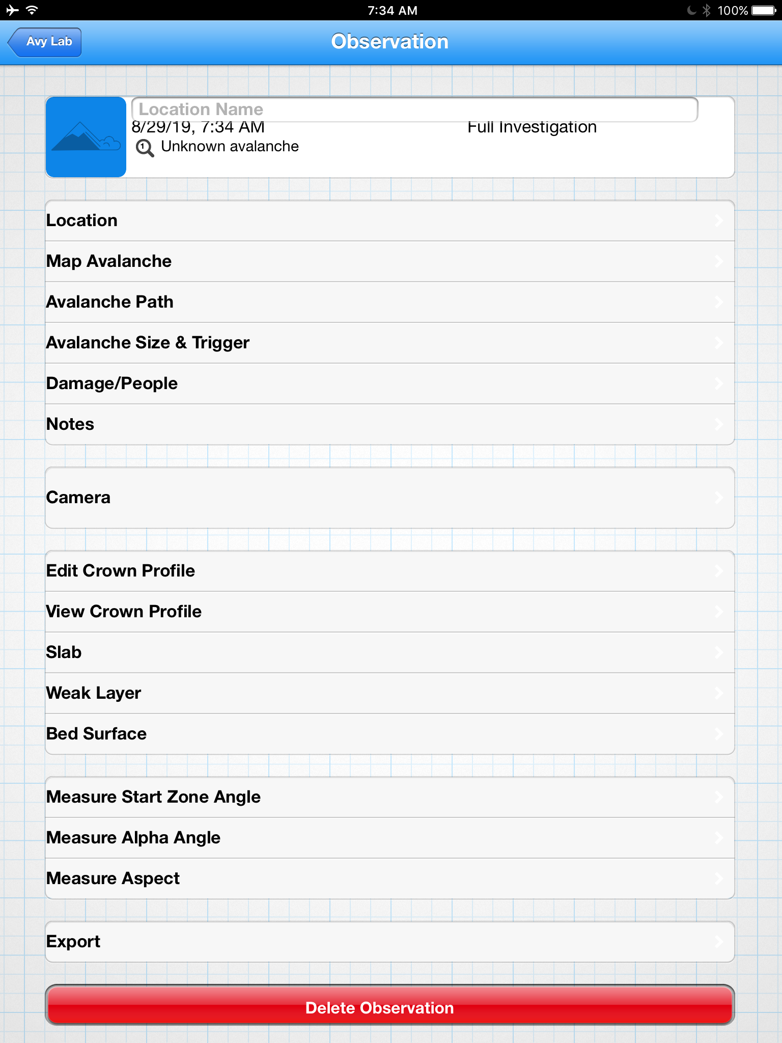
Main Screen > Record Data Drop-down Menu > Avalanche Obs. > Full Investigation (PRO only)
Notes:
This is just a more in-depth version of the “quick investigation” screen, with the addition of screens for slab, weak layer, and base layer. In addition there are places to log start zone and alpha angles as well as a measurement aspect.
Front Range Forecast
Avy: Full Invest.
Features:
Standard base features as “quick Obs”
Ability to view/edit/create crown profiles
Additional Entry of Slab characteristics
Additional Weak Layer ID
Additional Base Layer ID
Additional Start Zone and Alpha Angel ID
©2009 Renaissance Recreation. All Rights reserved.
Ad Space
Ad Space
©2009 Renaissance Recreation. All Rights reserved.

Slide 16
Main Screen > View Data Drop-Down Menu
Front Range Forecast
Main Menu
Notes:
This screen allows users to view their data, and their groups that they have sorted their data into. It also allows them to view ALL public data.
Record Data
View Data
My Data
My Data + My Groups
ALL Data
Share Data
©2009 Renaissance Recreation. All Rights reserved.
Ad Space
Ad Space
©2009 Renaissance Recreation. All Rights reserved.

Slide 17
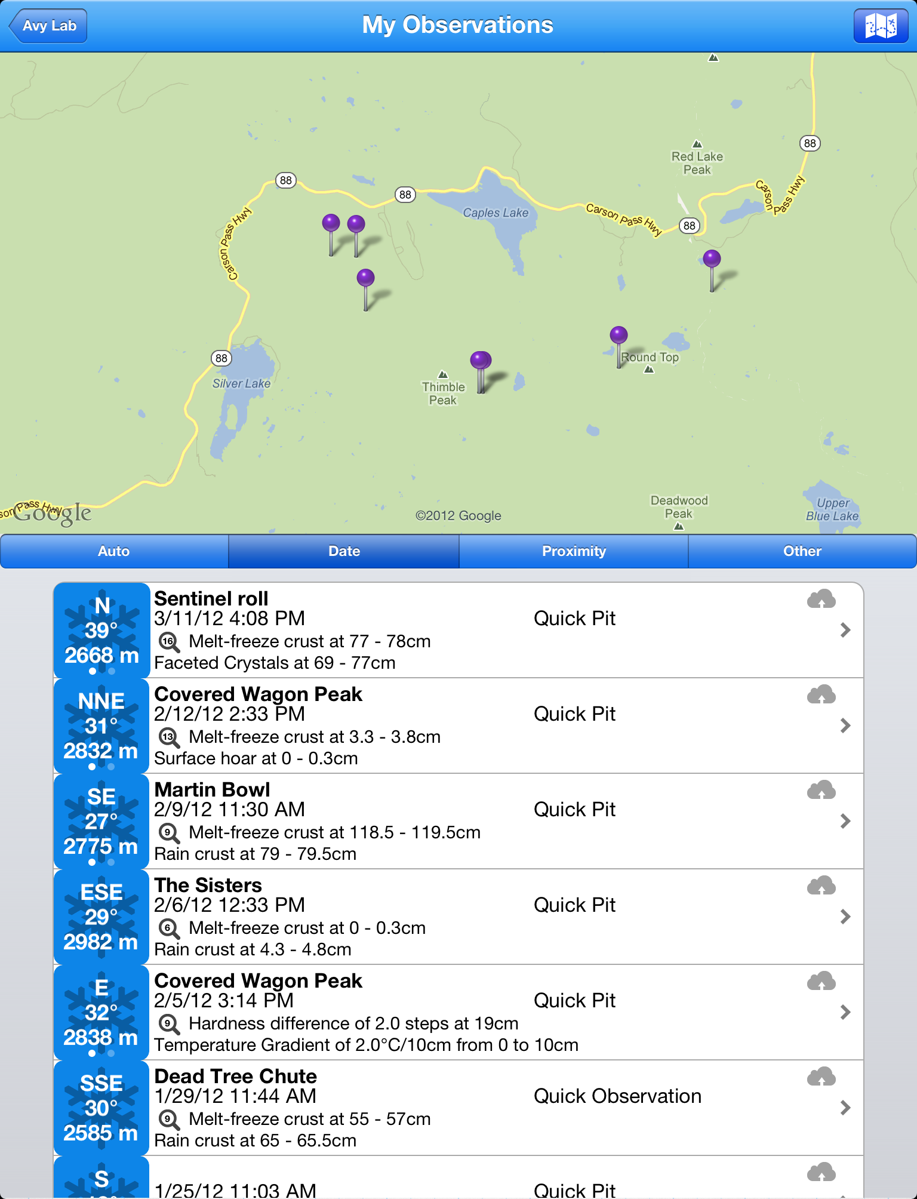
Main Screen > View Data Drop-Down Menu > My Data
Notes:
This screen displays all of the users data on the map.
Front Range Forecast
My Data
Features:
Displays Only the users data points for quick access and sorting
©2009 Renaissance Recreation. All Rights reserved.
Ad Space
Ad Space
©2009 Renaissance Recreation. All Rights reserved.

Slide 18
Main Screen > View Data Drop-Down Menu > My Data + My Groups
Notes:
This page allows users to view their data, but also view data based on their groups and/or categories that they have sorted them into. There also needs to be a quick toggle on/off for each group so the group data displayed is easy to manage.
Front Range Forecast
My Data + My Groups
Features:
Shows users data
Displays the users group and the data ( with quick toggle on/off for each group
Group A Data:
©2009 Renaissance Recreation. All Rights reserved.
Ad Space
Ad Space
©2009 Renaissance Recreation. All Rights reserved.

Slide 19
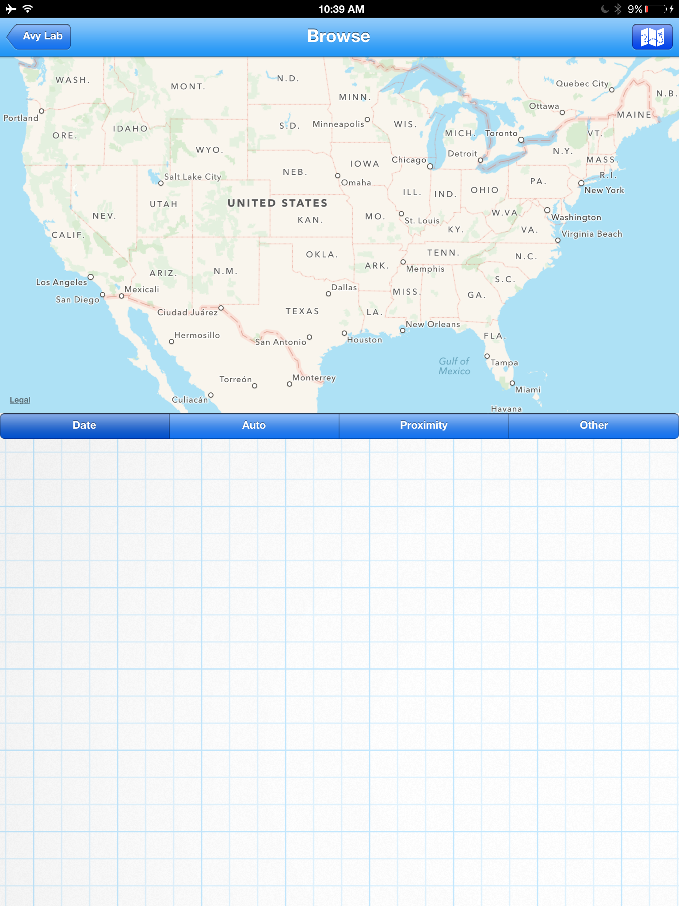
Main Screen > View Data Drop-Down Menu > All Data
Notes:
This is where in addition to the main screen, users can view and access all of the public data for the avalanche lab database.
Front Range Forecast
Browse All Data
Features:
This is the “browse Data” page of the current app
Allows users to see all public data available
©2009 Renaissance Recreation. All Rights reserved.
Ad Space
Ad Space
©2009 Renaissance Recreation. All Rights reserved.

Slide 20
Main Screen > Share Data Drop-Down Menu
Notes:
This page is where users can decide how they want to share their data. They can share data via there groups, view public groups and organizations data, or share their data via email, social media, or online.
Front Range Forecast
Main Menu
Share Data
My Groups
Public Groups
Organizations
Share Via
Toolbox
©2009 Renaissance Recreation. All Rights reserved.
Ad Space
Ad Space
©2009 Renaissance Recreation. All Rights reserved.

Slide 21
Main Screen > Share Data Drop-Down Menu > My Groups
Notes:
This screen allows users to create and view data by groups. This also allows users to add share data with a group of users. From this screen users can view groups, edit groups or create a new group.
Front Range Forecast
Front Range Forecast
My Groups
AVALANCHE LAB
+ New Group
My Groups
Share Data
Group A
Features:
Create New Groups
Manage Groups
My Groups
Group B
Others Groups
Group C
Group D
Organizations
Social Media
Toolbox
©2009 Renaissance Recreation. All Rights reserved.
©2009 Renaissance Recreation. All Rights reserved.
Ad Space
Ad Space
Ad Space
Ad Space
©2009 Renaissance Recreation. All Rights reserved.
©2009 Renaissance Recreation. All Rights reserved.

Slide 22
Main Screen > Share Data Drop-Down Menu > My Groups > Group A
Notes:
When a group is selected, users can be added to the group, in addition settings and info about the group can be edited.
Front Range Forecast
Group A
Group A
User A
User B
Features:
Edit Members
Change Group Settings
User C
+ New Member
Group Settings
©2009 Renaissance Recreation. All Rights reserved.
Ad Space
Ad Space
©2009 Renaissance Recreation. All Rights reserved.

Slide 23
Main Screen > Share Data Drop-Down Menu > Public Groups
Notes:
These are groups for public places, organizations, and groups, that wish to share data via a common location. They can be joined by anyone, and the data is collected and shared via group members in a folder or toggle bar for the group.
Front Range Forecast
Public Groups
(Search)
B-Pass
Red Mountain Pass
Features:
A comprehensive list of the public groups for data sharing
Search bar on top
Loveland Pass Riders
CMC Members
©2009 Renaissance Recreation. All Rights reserved.
Ad Space
Ad Space
©2009 Renaissance Recreation. All Rights reserved.

Slide 24
Main Screen > Share Data Drop-Down Menu > Avalanche Centers
Notes:
These are formalized not for profit organizations who’s goals are of public benefit or are avalanche forecast centers.
Front Range Forecast
Avalanche Centers
(Search)
CAIC
UAC
Features:
- Allows users to subscribe and view data managed by their local avalanche center
NWAC
©2009 Renaissance Recreation. All Rights reserved.
Ad Space
Ad Space
©2009 Renaissance Recreation. All Rights reserved.

Slide 25
Main Screen > Share Data Drop-Down Menu > Share Via
Notes:
This page allows users to share via, email, Facebook ,YouTube, or Instagram. This share menu can also be accessed from the “share” button on a data point.
Front Range Forecast
AVALANCHE LAB
Share Data
Features:
User can share via email, or social media.
Most likely this will be sharing trips to try to get more group members. OR it could be a cool observation to share on the avalanche lab Facebook page? Who knows?
Share Via Email
Share Via Facebook
Share Via You Tube
Share Via Instagram
©2009 Renaissance Recreation. All Rights reserved.
Ad Space
Ad Space
©2009 Renaissance Recreation. All Rights reserved.

Slide 26
Main Screen > Toolbox Drop-Down Menu
Notes:
The toolbox is likely to be one of the most used sections of the app. From this menu, people can used the phone based tools, and also reference information relevant for field assessments
Front Range Forecast
AVALANCHE LAB
Toolbox
AvyLab Trip Planner
Run Logger
Rescue Guide
Reference Information
Clinometer
Compass
Crystal Card/Library
©2009 Renaissance Recreation. All Rights reserved.
Ad Space
Ad Space
©2009 Renaissance Recreation. All Rights reserved.

Slide 27
Main Screen > Toolbox Drop-Down Menu > Trip Planner
Notes:
This screen shows the saved trips. When you click the “trip” it will allow users to edit the trip info. If you click “play” button next to the trip, it should launch into the trip running feature. When the “+” is hit, it should launch a new trip screen.
Front Range Forecast
Your Trips
Features:
Users can view saved trips
Create New Trips
Run a saved Trip
+
>
Trip A
©2009 Renaissance Recreation. All Rights reserved.
Ad Space
Ad Space
©2009 Renaissance Recreation. All Rights reserved.

Slide 28
Main Screen > Toolbox Drop-Down Menu > Trip Planner > Trip Planner (New Trip)
Notes:
When a new trip is selected, the user can enter info on the trip in the 5 categories . When done, the user can use the “done” button to save the trip.
New Trip Categories:
General Info:
Group:
Avalanche Hazard:
Trip Information:
Emergency Plan:
Front Range Forecast
New Trip
General Info
Group
Avalanche Hazard
Trip Information
Emergency Plan
Features:
Create a comprehensive trip plan with the help of the AIARE Risk Management Framework
Done
©2009 Renaissance Recreation. All Rights reserved.
Ad Space
Ad Space
©2009 Renaissance Recreation. All Rights reserved.

Slide 29
Main Screen > Toolbox Drop-Down Menu > Trip Planner > Trip Planner (New Trip) > General Info
Notes:
Users can enter general info about their trip.
Front Range Forecast
New Trip
General Info
Name:
Location:
Features:
Pin-Point Location for trailhead
Trail Head:
Cell Signal?:
©2009 Renaissance Recreation. All Rights reserved.
Ad Space
Ad Space
©2009 Renaissance Recreation. All Rights reserved.

Slide 30
Main Screen > Toolbox Drop-Down Menu > Trip Planner > Trip Planner (New Trip) > Group
Notes:
This is the screen for viewing/selecting the group for the trip. Also they can create a new group at the bottom of the menu.
Front Range Forecast
My Groups
My Groups
Features:
View Users Groups
Create New Groups
Group A
Group B
Group C
+ New Group
©2009 Renaissance Recreation. All Rights reserved.
Ad Space
Ad Space
©2009 Renaissance Recreation. All Rights reserved.

Slide 31
Main Screen > Toolbox Drop-Down Menu > Trip Planner > Trip Planner (New Trip) > Group > New Group
Notes:
This is where users can create a group, add members, and edit settings for the group.
Front Range Forecast
My Groups
New Groups
New Group Name…
Me
Features:
- Edit Group Members
+ New Member
Group Settings
©2009 Renaissance Recreation. All Rights reserved.
Ad Space
Ad Space
©2009 Renaissance Recreation. All Rights reserved.

Slide 32
Main Screen > Toolbox Drop-Down Menu > Trip Planner > Trip Planner (New Trip) > Group > Group Edit
Notes:
This is the edit screen where you put in/edit the new members
Front Range Forecast
Edit Group
My Groups
Group A
Member A
Features:
Member B
Member C
+ New Member
Group Settings
©2009 Renaissance Recreation. All Rights reserved.
Ad Space
Ad Space
©2009 Renaissance Recreation. All Rights reserved.

Slide 33
Main Screen > Toolbox Drop-Down Menu > Trip Planner > Trip Planner (New Trip) > Group > Group Edit > Group Settings
Notes:
This is the page that allows users to select settings for their group.
Public vs private:
Send data:
Group description:
Group logo:
Group notes:
Group:
- + Group
- + New Group Member
Front Range Forecast
New Trip
My Groups
Group A Settings
Public vs Private:
Features:
Select public vs private group status
Assign settings for sending data for group
Send Data:
Group Description:
Group Logo:
Group Notes:
©2009 Renaissance Recreation. All Rights reserved.
Ad Space
Ad Space
©2009 Renaissance Recreation. All Rights reserved.

Slide 34
Main Screen > Toolbox Drop-Down Menu > Trip Planner > Trip Planner (New Trip) > Group > Group Manager > Group Edit > New Member Sub Menu
Notes:
This sub menu allows users to lookup users or add a new group member.
Front Range Forecast
New Trip
My Groups
Group A
User A
Features:
-Add new group member from scratch or lookup someone on the avalanche lab network
User B
User C
+ New Member
Lookup Member
+ New Member
©2009 Renaissance Recreation. All Rights reserved.
Ad Space
Ad Space
©2009 Renaissance Recreation. All Rights reserved.

Slide 35
Main Screen > Toolbox Drop-Down Menu > Master Planner > Trip Planner (New Trip) > Group > Group Manager > Group Edit > New Member Sub Menu > Member Lookup
Notes:
This screen allows the members to be looked up or searched.
Front Range Forecast
Lookup Users
(Search)
Name
User Name
State
Features:
Allows users to look up and view other members
Search for users
©2009 Renaissance Recreation. All Rights reserved.
Ad Space
Ad Space
©2009 Renaissance Recreation. All Rights reserved.

Slide 36
Main Screen > Toolbox Drop-Down Menu > Master Planner > Trip Planner (New Trip) > Group > Group Manager > Group Edit > New Member Sub Menu > Add New Member
Notes:
This screen allows new info to be entered for a new member into the group.
Front Range Forecast
New Group Member
New Group Members
Name:
Cell Phone:
Features:
-
DOB:
Fallows ”The Code”
Risk Tolerance
Health Issues
Riding Style:
©2009 Renaissance Recreation. All Rights reserved.
Misc. Notes:
Ad Space
Ad Space
©2009 Renaissance Recreation. All Rights reserved.

Slide 37
Main Screen > Toolbox Drop-Down Menu > Master Planner > Trip Planner (New Trip) > Avalanche Hazard
Notes:
This screen allows for data to be entered relating to the hazard for the terrain, and the trip selected.
Front Range Forecast
New Trip
Avalanche Hazard
ATES Rating for Terrain:
Known Avalanche Hazar
Features:
Misc. Terrain Notes
©2009 Renaissance Recreation. All Rights reserved.
Ad Space
Ad Space
©2009 Renaissance Recreation. All Rights reserved.

Slide 38
Main Screen > Toolbox Drop-Down Menu > Master Planner > Trip Planner (New Trip) > Trip Info
Notes:
This screen allows users to enter info for the trip.
Front Range Forecast
New Trip
Trip Information
Trip Plan:
Run List:
Hot Spots:
Features:
Alt Plan
?????
????
©2009 Renaissance Recreation. All Rights reserved.
Ad Space
Ad Space
©2009 Renaissance Recreation. All Rights reserved.

Slide 39
Main Screen > Toolbox Drop-Down Menu > Master Planner > Trip Planner (New Trip) > Emergency Plan
Notes:
This is where the user can enter an emergency plan for the trip.
Front Range Forecast
New Trip
Emergency Plan
Meet Up Locations:
Communication Plan:
Features:
Local Emergency Services:
??????
?????
????
©2009 Renaissance Recreation. All Rights reserved.
Ad Space
Ad Space
©2009 Renaissance Recreation. All Rights reserved.

Slide 40
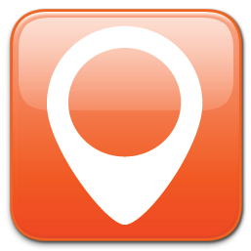
Main Screen > Toolbox Drop-Down Menu > Master Planner > Run Trip
Notes:
This is the “run” state that allows users to access the info entered on the previous screens. This will be the main screen that the user will access trips in the field environment.
Front Range Forecast
AVALANCHE LAB
(Name, ATES, Run List, Time)
Plan
Ride
Debrief
Features:
View Trip Info
View your PRD for a trip
View your location on the map
Use tools like a compass or clinometer to asses your areas
+
©2009 Renaissance Recreation. All Rights reserved.
Ad Space
Ad Space
©2009 Renaissance Recreation. All Rights reserved.

Slide 41
Main Screen > Toolbox Drop-Down Menu > Master Planner > Run Trip > Enter Quick Obs.
Notes:
This allows the user to access the quick observation screen from the trip interface
Front Range Forecast
AVALANCHE LAB
(Name, ATES, Run List, Time)
Plan
Ride
Debrief
Features:
Enter obs quickly and easily while in the field
©2009 Renaissance Recreation. All Rights reserved.
Ad Space
Ad Space
©2009 Renaissance Recreation. All Rights reserved.

Slide 42
Main Screen > Toolbox Drop-Down Menu > Master Planner > Run Trip > Trip A Info
Notes:
This screen allows the user to view/edit their trip on the fly.
New Trip Categories:
General Info:
Group:
Avalanche Hazard:
Trip Information:
Emergency Plan:
Front Range Forecast
Trip A
General Info
Group
Avalanche Hazard
Features:
Trip Information
Emergency Plan
©2009 Renaissance Recreation. All Rights reserved.
Ad Space
Ad Space
©2009 Renaissance Recreation. All Rights reserved.

Slide 43
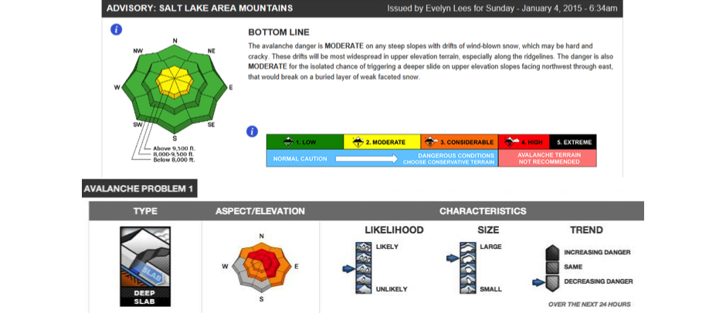
Main Screen > Toolbox Drop-Down Menu > Master Planner > Run Trip > Plan
Notes:
The plan screen allows users to view and access the avalanche forecast , then review their plan details entered prior to the trip. When re-running a trip, it should ask you if “do you want to refresh the forecast?”, this way the user gets a fresh forecast each trip.
In addition, I would like for ATES Rating, Run List, Hot Spot’s, Alt Plan, then the remaining menu items in the order of the drop down to the left.
ATES: simple:green, challenging:yellow, Complex:Red)
Hotspots: # of hotspots text is red
Drop Down List:
General Info:
Group:
Trip Plan:
ATES:
Run List:
Hot Spots:
Alt Plan:
Emergency Plan:
Front Range Forecast
AVALANCHE LAB
(Name, ATES, Run List, Time)
Plan
Ride
Debrief
Features:
Download and view avalanche forecast quickly in the plan screen
View saved info about the trip
Quickly view ATES Rating, Run List, and Hot Spots for easy field review
ATES Rating: Simple
Run List: 4 Runs
©2009 Renaissance Recreation. All Rights reserved.
Hot Spots: 2 Hot Spots
Ad Space
Ad Space
©2009 Renaissance Recreation. All Rights reserved.

Slide 44
Main Screen > Toolbox Drop-Down Menu > Master Planner > Run Trip > Ride
Drop Down List:
Parking Lot Check:
Departure Check
Beacon Check
Rider Check-in’s:
Conditions on Route ( + obs)
Group Check-in
Avalanche Terrain Check
Problems ( 1&2)
Reminders
Pre Run Checklist:
Avalanche Terrain Check
Key Obs
Run List Check
Safe Spots/Ski Plan
Communication Plan
Safe Terrain Management Plan
Notes:
These are standardized checklists, and if you need more info, then there should be a button to link to the site avalanchelab.org/tripplannerhelp
Front Range Forecast
AVALANCHE LAB
(Name, ATES, Run List, Time)
Plan
Ride
Debrief
Features:
Checklists for easy reference in the field
Link to help page @ avylab.org
Parking Lot Check
Rider Check-in’s
Pre-Run Check
©2009 Renaissance Recreation. All Rights reserved.
Ad Space
Ad Space
©2009 Renaissance Recreation. All Rights reserved.

Slide 45
Main Screen > Toolbox Drop-Down Menu > Master Planner > Run Trip > Debrief
Notes:
This screen should have each menu item access a screen where users can enter info about the trip. The format for the data entry should be question in bold font above, with free text below each question. These should reset with each new trip.
Questions:
Summarize Conditions:
How did today’s Weather affect conditions?
What is the primary avalanche concern?
Is the danger increasing or decreasing?
Review Decisions:
What were the Pro’s and Con’s of today’s plan?
Where were we most exposed to avalanche risk?
Where were we most at risk?
Improve:
What could we have done better?
Did we submit our obs to our local avalanche center? (IF NOT CLICK HERE TO SUBMIT, or CLICK HERE TO TURN ON IN SETTINGS)
Front Range Forecast
AVALANCHE LAB
(Name, ATES, Run List, Time)
Plan
Ride
Debrief
Summarize Conditions
Review Decisions
Improve
©2009 Renaissance Recreation. All Rights reserved.
Ad Space
Ad Space
©2009 Renaissance Recreation. All Rights reserved.
Features:
- Allows users to recap the day and recount lessons learned for the next adventure

Slide 46
Main Screen > Toolbox Drop-Down Menu > Master Planner > Run Trip > Debrief > Summarize Conditions
Notes:
The format for the data entry should be question in bold font above, with free text below each question. These should reset with each new trip.
Questions:
Summarize Conditions:
How did today’s Weather affect conditions?
What is the primary avalanche concern?
Is the danger increasing or decreasing?
Front Range Forecast
AVALANCHE LAB
(Name, ATES, Run List, Time)
Plan
Ride
Debrief
Summarize Conditions
©2009 Renaissance Recreation. All Rights reserved.
Ad Space
Ad Space
©2009 Renaissance Recreation. All Rights reserved.

Slide 47
Main Screen > Toolbox Drop-Down Menu > Master Planner > Run Trip > Debrief > Review Decisions
Notes:
The format for the data entry should be question in bold font above, with free text below each question. These should reset with each new trip.
Questions:
Review Decisions:
What were the Pro’s and Con’s of today’s plan?
Where were we most exposed to avalanche risk?
Where were we most at risk?
Front Range Forecast
AVALANCHE LAB
(Name, ATES, Run List, Time)
Plan
Ride
Debrief
Summarize Conditions
Review Decisions
©2009 Renaissance Recreation. All Rights reserved.
Ad Space
Ad Space
©2009 Renaissance Recreation. All Rights reserved.

Slide 48
Main Screen > Toolbox Drop-Down Menu > Master Planner > Run Trip > Debrief > Improve
Notes:
The format for the data entry should be question in bold font above, with free text below each question. These should reset with each new trip.
Questions:
Improve:
What could we have done better?
Did we submit our obs to our local avalanche center? (IF NOT CLICK HERE TO SUBMIT, or CLICK HERE TO TURN ON IN SETTINGS)
Front Range Forecast
AVALANCHE LAB
(Name, ATES, Run List, Time)
Plan
Ride
Debrief
Summarize Conditions
Review Decisions
Improve
©2009 Renaissance Recreation. All Rights reserved.
Ad Space
Ad Space
©2009 Renaissance Recreation. All Rights reserved.

Slide 49
Main Screen > Toolbox Drop-Down Menu > Run Logger
Notes:
This screen shows the saved trips. When you click the “trip” it will allow users to edit the trip info. If you click “play” button next to the trip, it should launch into the trip running feature. When the “+” is hit, it should launch a new trip screen.
Front Range Forecast
Your Trips
Features:
Users can view saved Runs
Create New Runs
Map New Runs
Label ”Hot Spots” for review later
Pin Point location
+
Run A
©2009 Renaissance Recreation. All Rights reserved.
Ad Space
Ad Space
©2009 Renaissance Recreation. All Rights reserved.

Slide 50
Main Screen > Toolbox Drop-Down Menu > Run Logger > Run Editer/New Trip
Notes:
This screen shows the saved trips. When you click the “trip” it will allow users to edit the trip info. If you click “play” button next to the trip, it should launch into the trip running feature. When the “+” is hit, it should launch a new trip screen.
Front Range Forecast
New/Edit Trip
Features:
Users can view saved trips
Create New Trips
Run a saved Trip
+
Run A
©2009 Renaissance Recreation. All Rights reserved.
Ad Space
Ad Space
©2009 Renaissance Recreation. All Rights reserved.

Slide 51
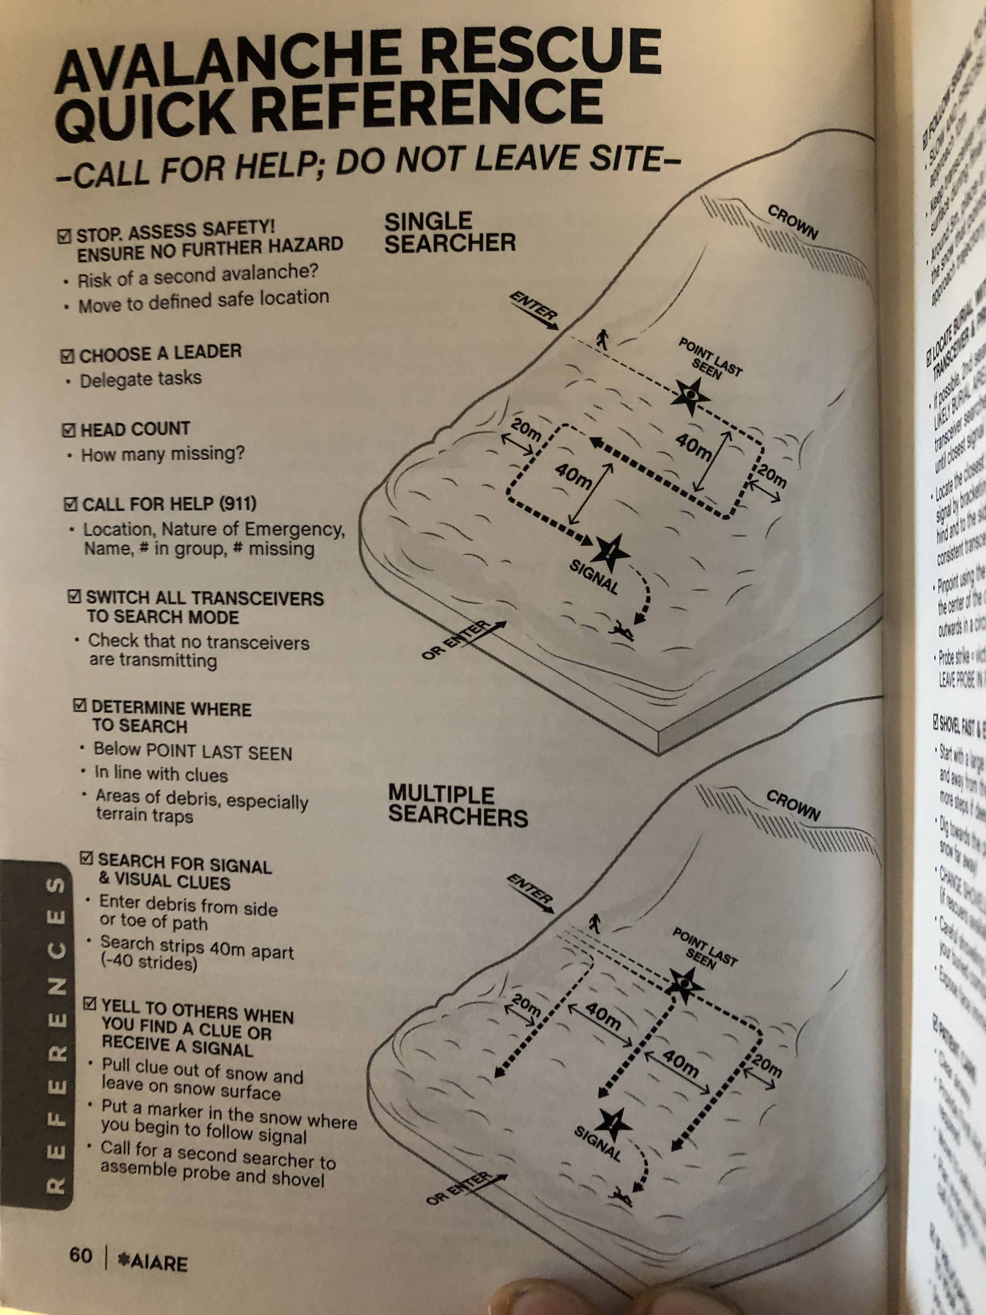
Main Screen > Toolbox Drop-Down Menu > Rescue Guide
Notes:
This will be a pdf, which allows the user to review rescue procedures.
Front Range Forecast
AVALANCHE LAB
Rescue Guide
Features:
-Quick reference to what is going on in an avalanche rescue
©2009 Renaissance Recreation. All Rights reserved.
Ad Space
Ad Space
©2009 Renaissance Recreation. All Rights reserved.

Slide 52
Main Screen > Toolbox Drop-Down Menu > Reference Info
Notes:
The reference info will link to files with the different reference material. Please let me know what format is best(pdf, jpeg,png,ect)
Reference Info:
- Avalanche Problems Info
- Avalanche Danger Scale
- Tendency for Fx in Field Tests
- Structure of Avalanche Problem
- Likelihood of Avalanches
- Distractive Size Class System
- Yellow Flag Info
Front Range Forecast
AVALANCHE LAB
Features:
- Quick PDF references for the field of quality information for improving your decision making
Reference Information
Avalanche Problems
Avalanche Danger Scale
Tendency for Fx in Field
Structure of Avalanche
Likelihood of Avalanche
©2009 Renaissance Recreation. All Rights reserved.
Distractive Size Class Sys
Ad Space
Ad Space
©2009 Renaissance Recreation. All Rights reserved.

Slide 53
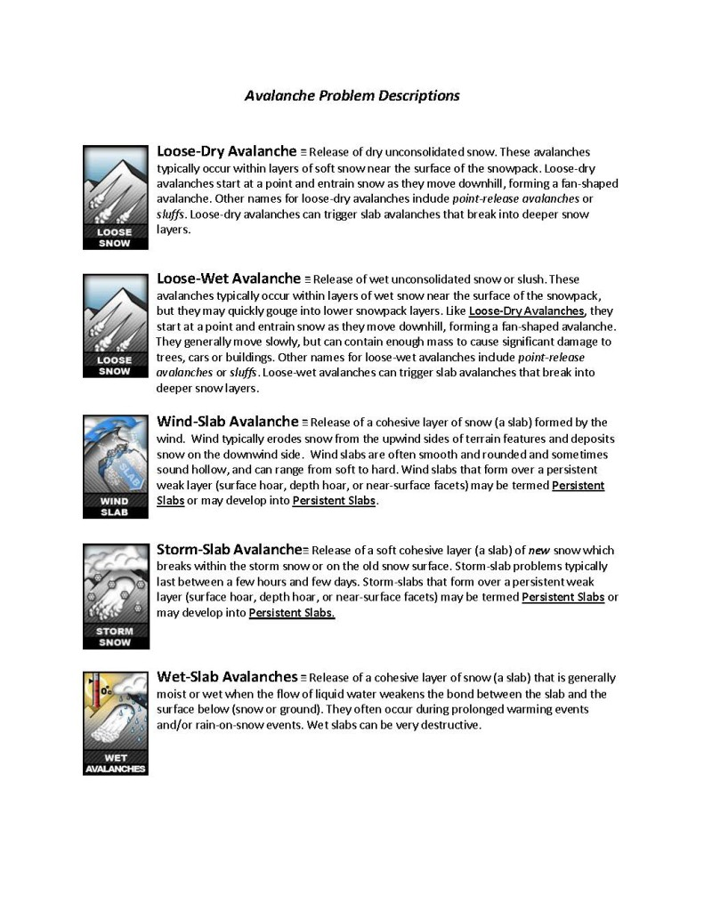
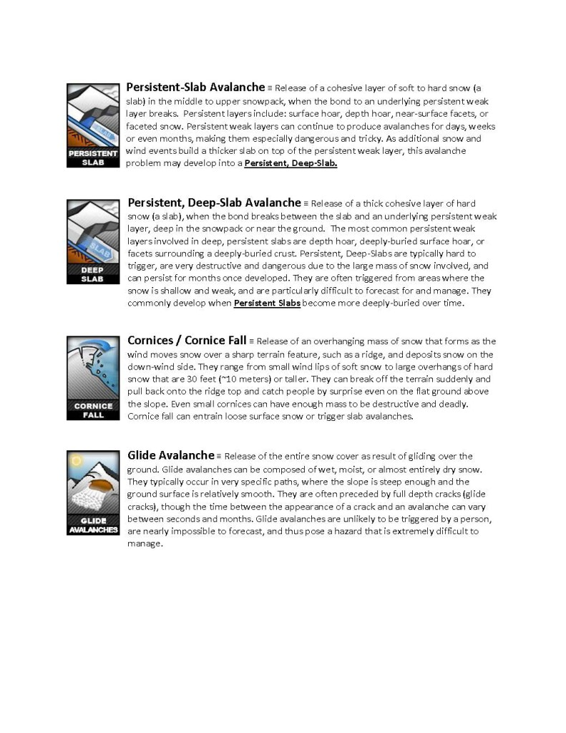
Main Screen > Toolbox Drop-Down Menu > Reference Info > Avalanche Problems Info
Notes:
Front Range Forecast
AVALANCHE LAB
Reference Information
©2009 Renaissance Recreation. All Rights reserved.
Ad Space
Ad Space
©2009 Renaissance Recreation. All Rights reserved.

Slide 54
Main Screen > Toolbox Drop-Down Menu > Reference Info > Avalanche Danger Scale
Notes:
Front Range Forecast
Avalanche Danger Scale
Reference Information
©2009 Renaissance Recreation. All Rights reserved.
Ad Space
Ad Space
©2009 Renaissance Recreation. All Rights reserved.

Slide 55
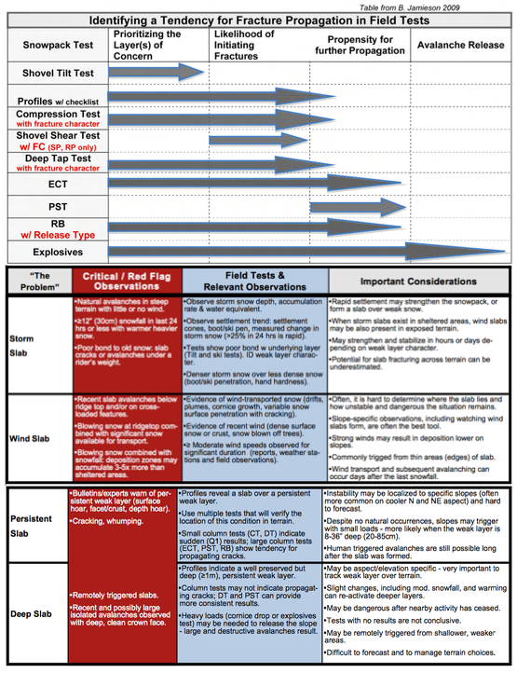
Main Screen > Toolbox Drop-Down Menu > Reference Info > Tendency for Fx in Field Tests
Notes:
Front Range Forecast
AVALANCHE LAB
Reference Information
©2009 Renaissance Recreation. All Rights reserved.
Ad Space
Ad Space
©2009 Renaissance Recreation. All Rights reserved.

Slide 56
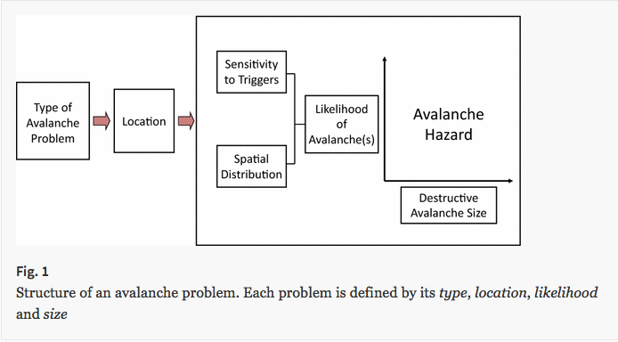
Main Screen > Toolbox Drop-Down Menu > Reference Info > Structure of Avalanche Problem
Notes:
Front Range Forecast
AVALANCHE LAB
Reference Information
©2009 Renaissance Recreation. All Rights reserved.
Ad Space
Ad Space
©2009 Renaissance Recreation. All Rights reserved.

Slide 57
Main Screen > Toolbox Drop-Down Menu > Reference Info > Likelihood of Avalanches
Notes:
Front Range Forecast
AVALANCHE LAB
Reference Information
©2009 Renaissance Recreation. All Rights reserved.
Ad Space
Ad Space
©2009 Renaissance Recreation. All Rights reserved.

Slide 58
Main Screen > Toolbox Drop-Down Menu > Reference Info > Distractive Size Class System
Notes:
Front Range Forecast
AVALANCHE LAB
Reference Information
©2009 Renaissance Recreation. All Rights reserved.
Ad Space
Ad Space
©2009 Renaissance Recreation. All Rights reserved.

Slide 59
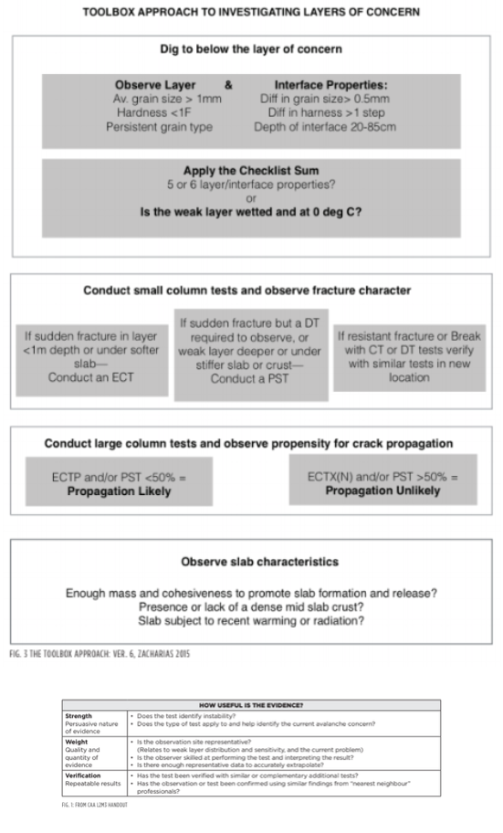
Main Screen > Toolbox Drop-Down Menu > Reference Info > Yellow Flag Info
Notes:
Front Range Forecast
AVALANCHE LAB
Reference Information
©2009 Renaissance Recreation. All Rights reserved.
Ad Space
Ad Space
©2009 Renaissance Recreation. All Rights reserved.

Slide 60
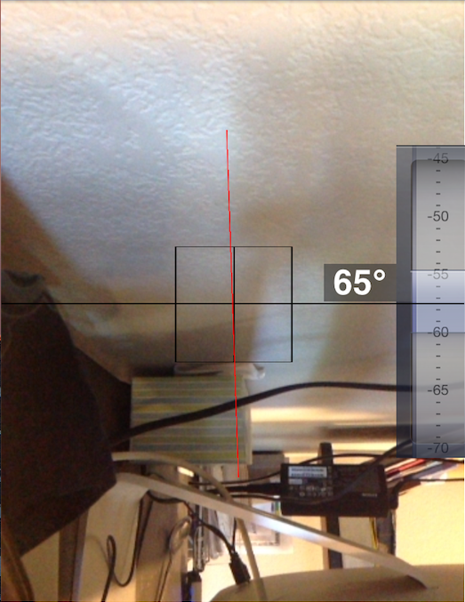
Main Screen > Toolbox Drop-Down Menu > Clinometer
Notes:
This is the Clinometer tool, this allows the user to slope angle using the tool from different positions on the slope. The tool was fully functional and should be good to go.
Front Range Forecast
AVALANCHE LAB
Features:
- Allows users to asses slope angle remotely and at different angles on the snow
©2009 Renaissance Recreation. All Rights reserved.
Ad Space
Ad Space
©2009 Renaissance Recreation. All Rights reserved.

Slide 61
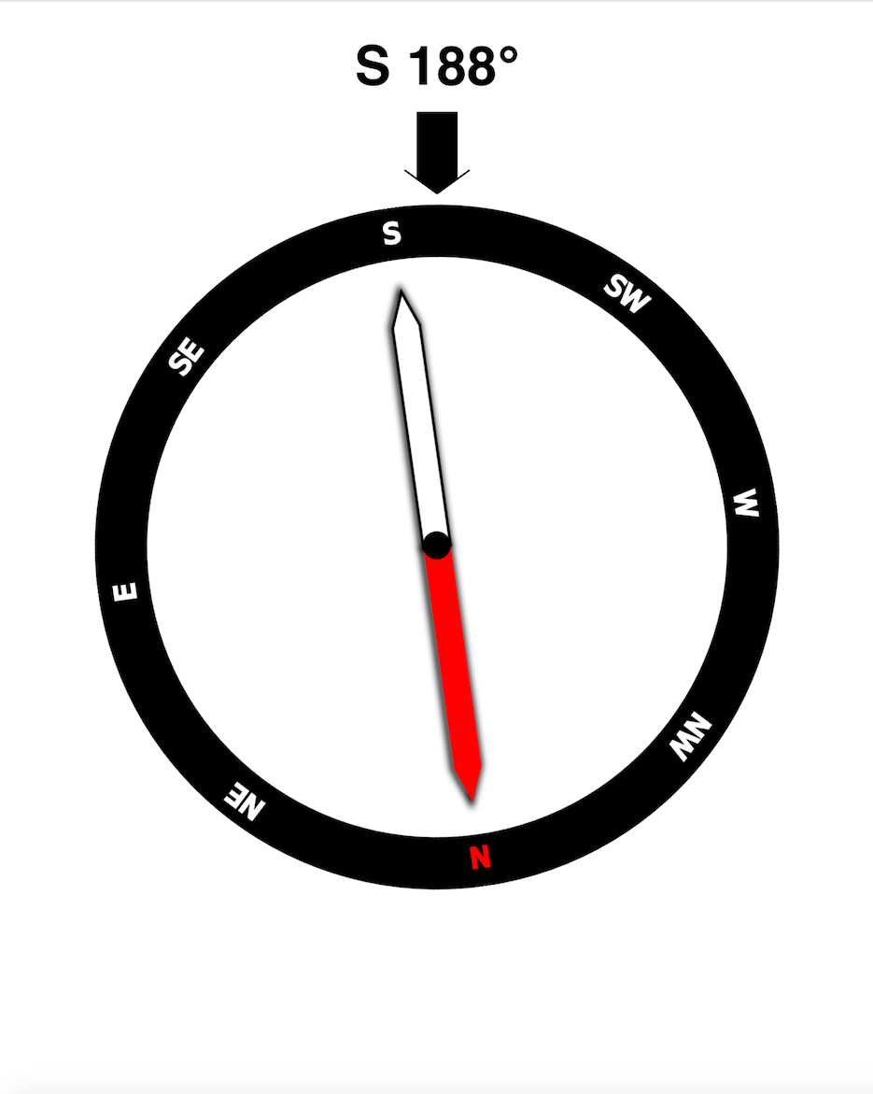
Main Screen > Toolbox Drop-Down Menu > Compass
Notes:
This is the compass tool, the only thing that’s lacking is a button to “Save Reading”. This will low users to store the bedding and return to the previous page.
Front Range Forecast
AVALANCHE LAB
SAVE
Features:
Users can take a heading
Save heading for input into data
©2009 Renaissance Recreation. All Rights reserved.
Ad Space
Ad Space
©2009 Renaissance Recreation. All Rights reserved.

Slide 62
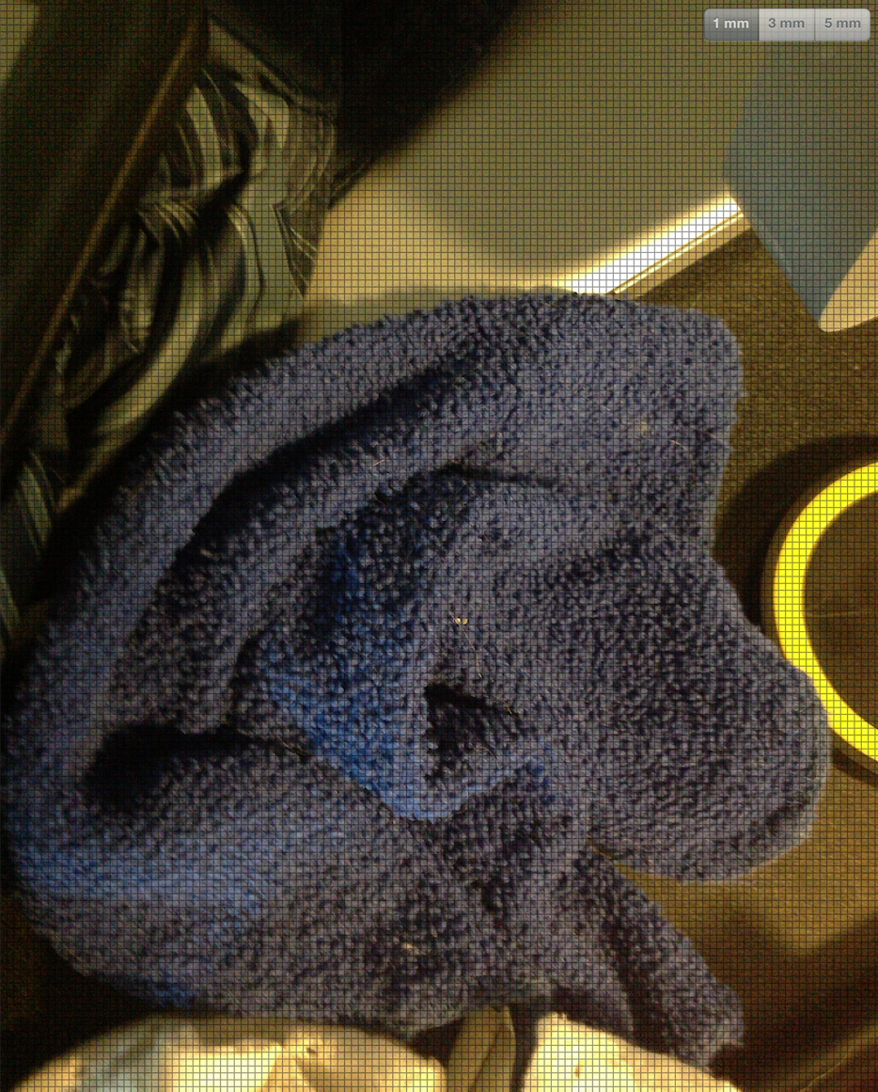
Main Screen > Toolbox Drop-Down Menu > Crystal Card Tool/Library
Notes:
This allows users to view and magnify snow crystals. With the addition of the camera button, users can grab screen shots of the snow crystals they are observing.
When the user clicks a button, I need it to take a screen shot and save it to the library. This has to be intuitive and easy for use with 1 hand in the field.
Front Range Forecast
AVALANCHE LAB
Features:
View snow crystals
Use camera to take photos of crystals
©2009 Renaissance Recreation. All Rights reserved.
Snow Crystal Library
Ad Space
Ad Space
©2009 Renaissance Recreation. All Rights reserved.

Slide 63
Main Screen > Toolbox Drop-Down Menu > Crystal Card Tool/Library Drop-Down
Notes:
This screen allows users to view the different snow crystal types. Once selected, the different subcategories are shown.
Front Range Forecast
AVALANCHE LAB
Features:
- Dropdown crystal library
Snow Crystal Library
Faceted Crystals
Rounded Grains
Precipitation Particles
©2009 Renaissance Recreation. All Rights reserved.
Decomposing & Fragme
Ad Space
Ad Space
©2009 Renaissance Recreation. All Rights reserved.

Slide 64
Main Screen > Toolbox Drop-Down Menu > Crystal Card Tool/Library Expanded
Notes:
Front Range Forecast
AVALANCHE LAB
Snow Crystal Library
Faceted Crystals
Near Surface F
Solid Faceted
©2009 Renaissance Recreation. All Rights reserved.
Rounded Grains
Ad Space
Ad Space
©2009 Renaissance Recreation. All Rights reserved.

Slide 65
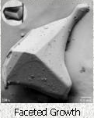
Main Screen > Toolbox Drop-Down Menu > Crystal Card Tool/Library Selected
Notes:
Once the subclass of crystal is selected, three different pictures of that crystal show up as a reference on the bottom of a split screen with the crystal viewer. The back button allows users to go back in the crystal library and pick another snow form to view on the split screen.
Front Range Forecast
AVALANCHE LAB
Features:
- Shows three different photos of the same snow phenomenon
Snow Crystal Library
©2009 Renaissance Recreation. All Rights reserved.
Ad Space
Ad Space
©2009 Renaissance Recreation. All Rights reserved.

Slide 66
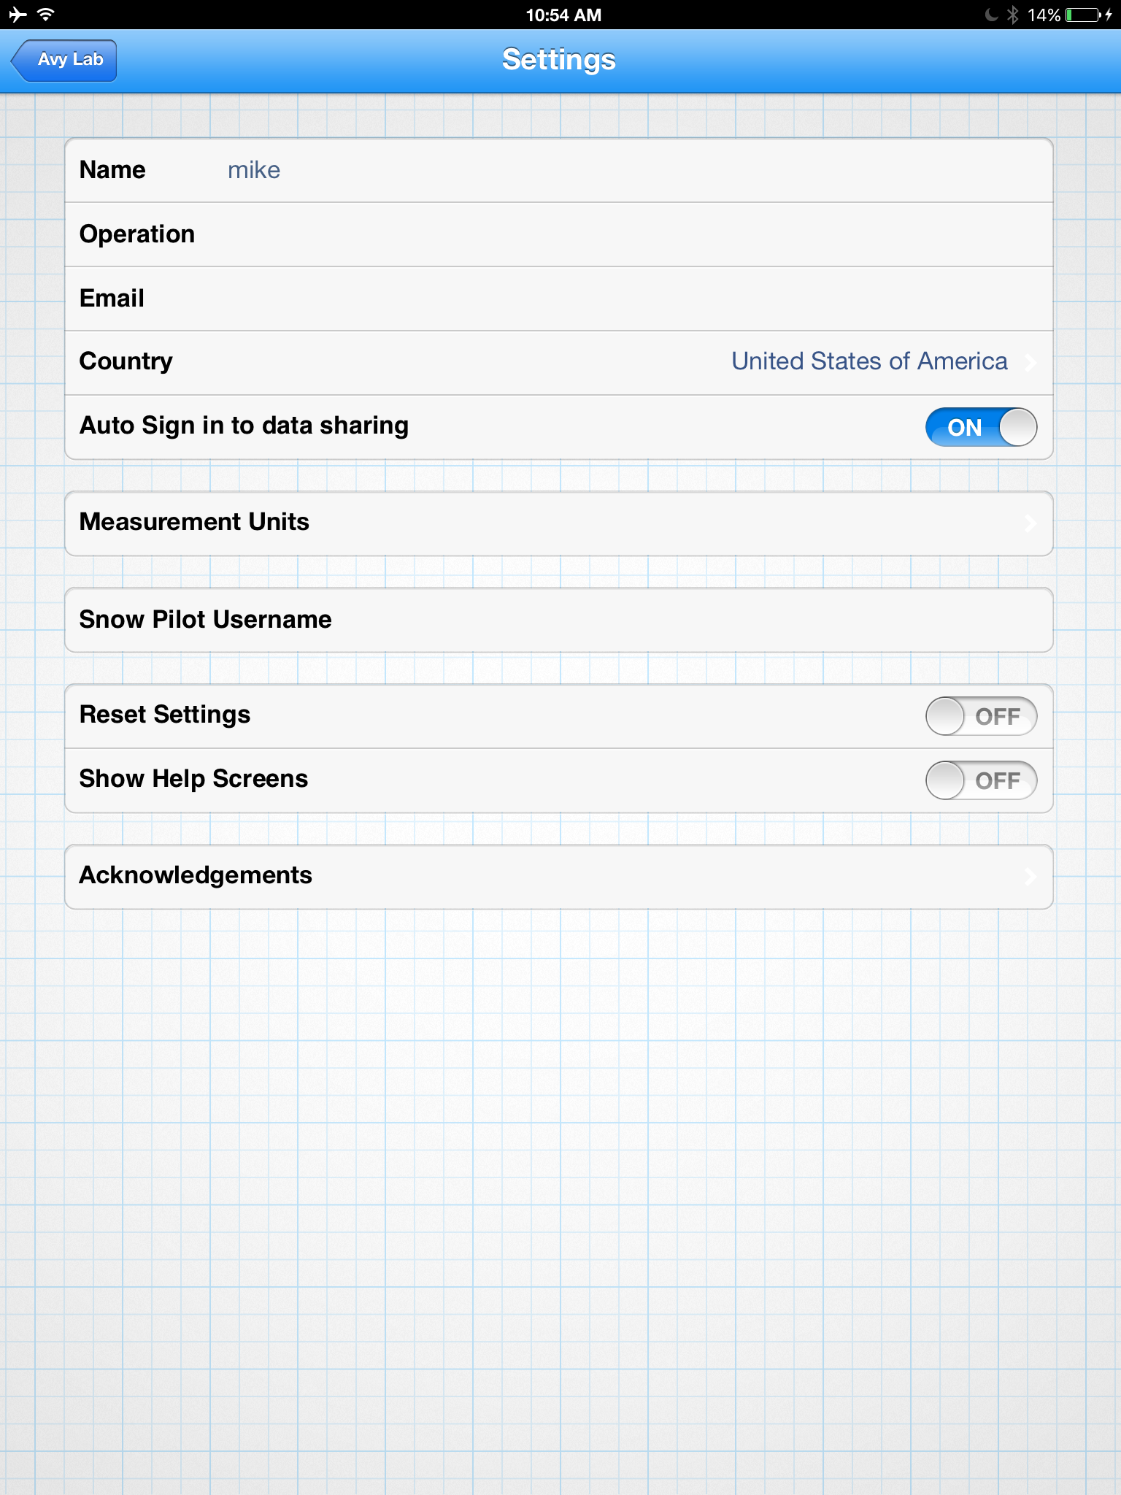
Main Screen > Settings Drop-Down Menu
Notes:
This is the settings menu, users can change settings on their profile, sharing, and general user settings.
Front Range Forecast
AVALANCHE LAB
Settings
Features:
- Allows users to change their profile, sharing settings, and general settings
©2009 Renaissance Recreation. All Rights reserved.
Ad Space
Ad Space
©2009 Renaissance Recreation. All Rights reserved.

Slide 67
Main Screen > Researchers Drop-Down Menu (web only)
Notes:
This is the dropdown for for researchers to control and access their data and public data on the avalanche lab data.
Front Range Forecast
AVALANCHE LAB
Toolbox
Features:
Settings
Researchers
My Data Downloads
My Data Access
View ALL Data
©2009 Renaissance Recreation. All Rights reserved.
Ad Space
Ad Space
©2009 Renaissance Recreation. All Rights reserved.

Slide 68
Main Screen > Researchers Drop-Down Menu > My Data Downloads
Notes:
This is where the researchers can set up data downloads, which allows them to access the Avalanche lab data set via the API protocols.
Front Range Forecast
AVALANCHE LAB
My Data Downloads
Data que 1
Data que 2
Features:
This is where researchers can view their data downloads and edit the details of those downloads.
The goal of this screen is to allow researchers to manage how they download data from the site
Data que 3
©2009 Renaissance Recreation. All Rights reserved.
Ad Space
Ad Space
©2009 Renaissance Recreation. All Rights reserved.

Slide 69
Main Screen > Researchers Drop-Down Menu > My Data Access
Notes:
This is where researchers can view their data, the data of their group/org, or ALL data.
Front Range Forecast
AVALANCHE LAB
My Data Access
View Data By Group
View My Data
Features:
View ALL Data
©2009 Renaissance Recreation. All Rights reserved.
Ad Space
Ad Space
©2009 Renaissance Recreation. All Rights reserved.

Slide 70
Main Screen > Researchers Drop-Down Menu > View ALL Data
Notes:
This is where researchers can view ALL data public and private.
Front Range Forecast
AVALANCHE LAB
Features:
- This is where researchers can view all public and private data for research purposes
©2009 Renaissance Recreation. All Rights reserved.
Ad Space
Ad Space
©2009 Renaissance Recreation. All Rights reserved.

